Slide 1
Machine Learning and Deep Learning in Earth Sciences:
Keypoints and Application
Pascal Oettli
June 7, 2022

Slide 2
Artificial Intelligence
Artificial Intelligence (AI): creating an artificial brain capable of doing as a human brain;
Machine Learning (ML): automatically learning rules from the data;
Deep Learning (DL): improving the learning by succesively layering the representation of the data;
Machine Learning
Feature Learning
Deep Learning
An Euler diagram of the common imbrication of concepts

Slide 3
 | Machine Learning | Deep Learning
Python | scikit-learn | Keras Tensorflow
R | caret tidymodels SuperLearner
Matlab |  | Tensorflow
Julia
Notes:
Pedregosa, F., and Coauthors, 2011: Scikit-learn: Machine Learning in Python. Journal of Machine Learning Research, 12, 2825–2830.
Kuhn, M., 2020: caret: Classification and Regression Training.
Kuhn, M., and H. Wickham, 2020: Tidymodels: a collection of packages for modeling and machine learning using tidyverse principles.
Chollet, F. and others, 2015: Keras.
Polley, E., E. LeDell, C. Kennedy, and M. van der Laan, 2021: SuperLearner: Super Learner Prediction.
Martín Abadi, and Coauthors, 2015: TensorFlow: Large-Scale Machine Learning on Heterogeneous Systems.

Slide 4
 | Machine Learning | Deep Learning
Python | scikit-learn | Keras Tensorflow
R | caret tidymodels SuperLearner
Matlab |  | Tensorflow
Julia
Notes:
Pedregosa, F., and Coauthors, 2011: Scikit-learn: Machine Learning in Python. Journal of Machine Learning Research, 12, 2825–2830.
Kuhn, M., 2020: caret: Classification and Regression Training.
Kuhn, M., and H. Wickham, 2020: Tidymodels: a collection of packages for modeling and machine learning using tidyverse principles.
Chollet, F. and others, 2015: Keras.
Polley, E., E. LeDell, C. Kennedy, and M. van der Laan, 2021: SuperLearner: Super Learner Prediction.
Martín Abadi, and Coauthors, 2015: TensorFlow: Large-Scale Machine Learning on Heterogeneous Systems.

Slide 5
Machine Learning

Slide 6
Scalars
Vectors
Matrices
Multidimensional Arrays

Slide 7
Chollet, F., 2018: Deep learning with Python. Manning Publications Co, 361 pp.
Rules
Classical Programming
Answers
Data

Slide 8
Chollet, F., 2018: Deep learning with Python. Manning Publications Co, 361 pp.
Data
Machine Learning
Rules
Answers
Notes:
Change of paradigm

Slide 9
Learning | Description
Unsupervised | Many features, learn useful properties of the structure of the dataset
Supervised | Involved labels or targets to inherit features associated to each label/target
Reinforcement | Feedback loop between learning system and its experiences

Slide 10
Text Analytics
Image Classification
Anomaly Detection
Recommenders
Purpose
Regression
Multiclass Classification
Clustering
Two-class Classification
Azure Machine Learning Team, 2021: Machine Learning Algorithm Cheat Sheet for Azure Machine Learning designer. Available at https://download.microsoft.com/download/3/5/b/35bb997f-a8c7-485d-8c56-19444dafd757/azure-machine-learning-algorithm-cheat-sheet-july-2021.pdf

Slide 11
Text Analytics
Image Classification
Anomaly Detection
Recommenders
Purpose
Regression
Multiclass Classification
Clustering
Two-class Classification

Slide 12
Clustering

Slide 13
Climate is characterized by nonlinearity and high dimensionality
Challenges:
reducing dimensionality of the system,
finding the most important patterns explaining the variations.
Techniques to extract coherent patterns:
Empirical Orthogonal Functions (EOF)
Singular Value Decomposition (SVD)
Canonical Correlation Analysis (CCA)
Independent Component Analysis (ICA)
k-means
Self-Organizing Map (SOM)
...

Slide 14
Climate is characterized by nonlinearity and high dimensionality
Challenges:
reducing dimensionality of the system,
finding the most important patterns explaining the variations.
Techniques to extract coherent patterns:
Empirical Orthogonal Functions (EOF)
Singular Value Decomposition (SVD)
Canonical Correlation Analysis (CCA)
Independent Component Analysis (ICA)
k-means
Self-Organizing Map (SOM)
...
Unsupervised

Slide 15
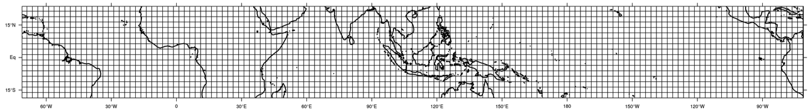
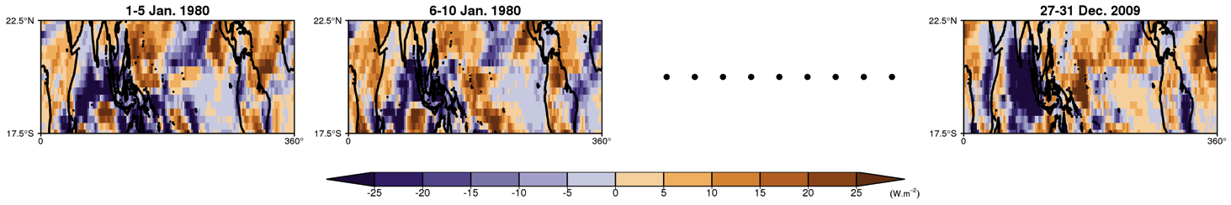
Input data
For the period 1980-2009, daily OLR (Liebmann and Smith 1996) filtered with a 20-100-day Lanczos bandpass filter (Duchon 1979, CLIVAR MJO Workgroup 2009), over the tropical region (0 – 360, 17.5°S – 22.5°N),
5-day anomalies from January to December (73 pentads) x 30 years,
As a result, a matrix consisting of 2190 pentads of data and 2448 grid points.
Notes:
Liebmann, B., and C. A. Smith, 1996: Description of a Complete (Interpolated) Outgoing Longwave Radiation Dataset. Bull. Amer. Meteor. Soc., 77, 1275–1277.
Duchon, C. E., 1979: Lanczos Filtering in One and Two Dimensions. J. Appl. Meteor., 18, 1016–1022, https://doi.org/10.1175/1520-0450(1979)018<1016:LFIOAT>2.0.CO;2.
Waliser, D., and Coauthors, 2009: MJO Simulation Diagnostics. J. Clim., 22, 3006–3030, https://doi.org/10.1175/2008JCLI2731.1.

Slide 16
Unsupervised vector quantization, used to produce a low-dimensional representation of high-dimensional datasets
Several description of an algorithmic clustering in the 1950’s by different independent researches
Official first description by H. Steinhaus in 1956
Term ”k-means” coined in 1967 by J. MacQueen
Notes:
Steinhaus, H., 1956: Sur la division des corps matériels en parties. Bulletin de l’Académie Polonaise des Sciences, IV, 801–804.
MacQueen, J., 1967: Some methods for classification and analysis of multivariate observations. Proceedings of the Fifth Berkeley Symposium on Mathematical Statistics and Probability, 1: Statistics, 281–297.

Slide 17
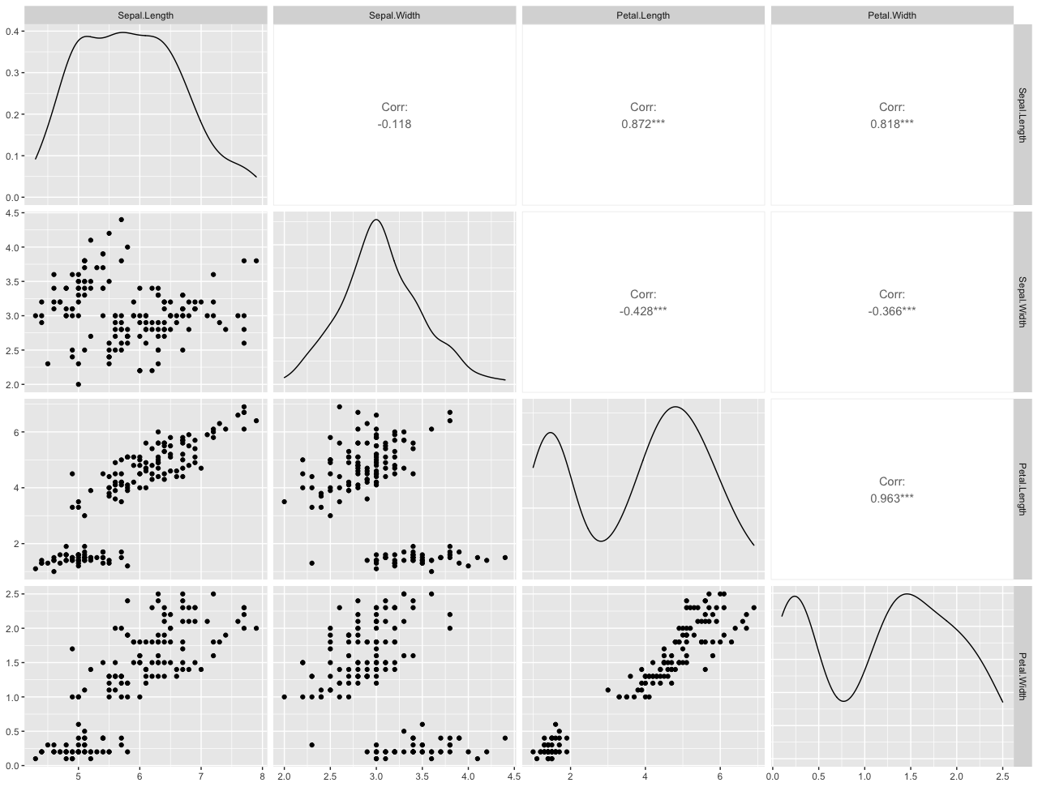
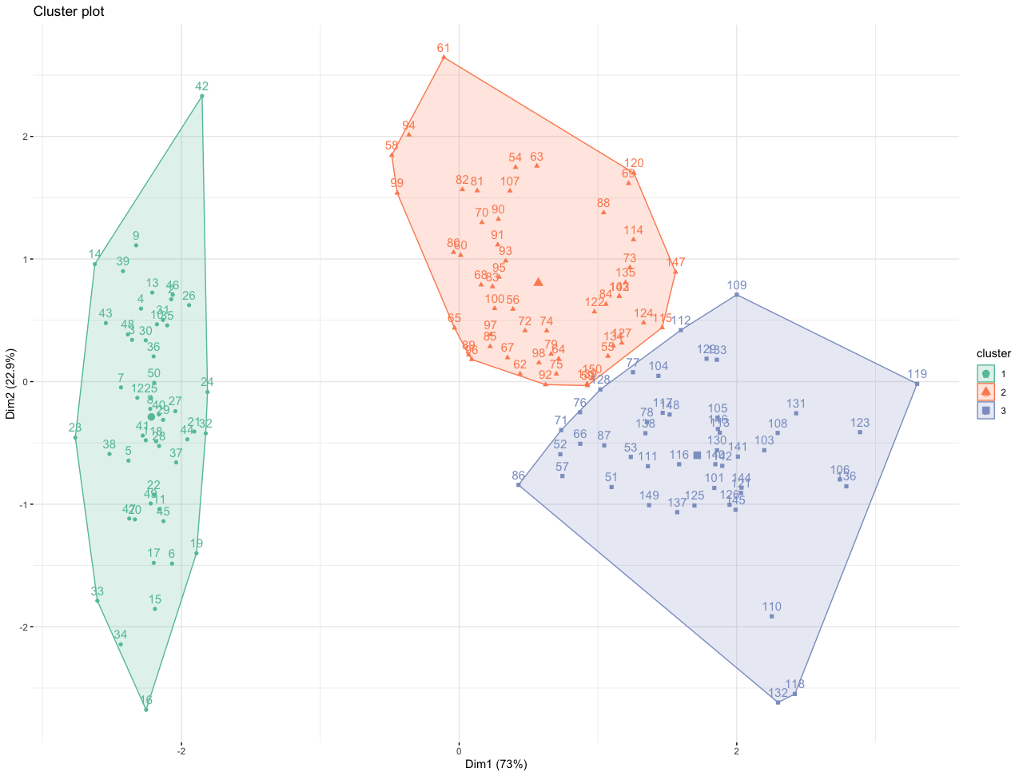
Deciding the number of classes,
Initializing to random centers,
Minimizing the intra-class variance and maximizing the inter-class variance
Algorithm | Lloyd/Forgy MacQueen Hartigan-Wong
k | Number of clusters
Notes:
Lloyd, S. P., 1957, published 1982: Least squares quantization in PCM. IEEE Transactions on Information Theory, 28, 129–137, https://doi.org/10.1109/TIT.1982.1056489.
Forgy, E. W., 1965a: Cluster analysis of multivariate data: Efficiency versus interpretability of classification. WNAR Meetings, Riverside, California.
——, 1965b: Cluster analysis of multivariate data: Efficiency versus interpretability of classification (Abstract). Biometrics, 21, 768–769.
MacQueen, J., 1967: Some methods for classification and analysis of multivariate observations. Proceedings of the Fifth Berkeley Symposium on Mathematical Statistics and Probability, 1: Statistics, 281–297.
Hartigan, J. A., and M. A. Wong, 1979: Algorithm AS 136: A k-means clustering algorithm. Journal of the Royal Statistical Society. Series C (Applied Statistics), 28, 100–108, https://doi.org/10.2307/2346830.
Morissette, L., and S. Chartier, 2013: The k-means clustering technique: General considerations and implementation in Mathematica. TQMP, 9, 15–24, https://doi.org/10.20982/tqmp.09.1.p015.

Slide 18
Deciding the number of classes,
Initializing to random centers,
Minimizing the intra-class variance and maximizing the inter-class variance
km.out <- kmeans(
x = OLR, # Matrix of data to cluster (time x space)
centers = n.centers, # Number of centers/clusters
iter.max = 500, # Maximum number of iterations for convergence
nstart = 10, # Number of random sets
algorithm = "Hartigan-Wong” # Algorithm (see previous table)
)

Slide 19
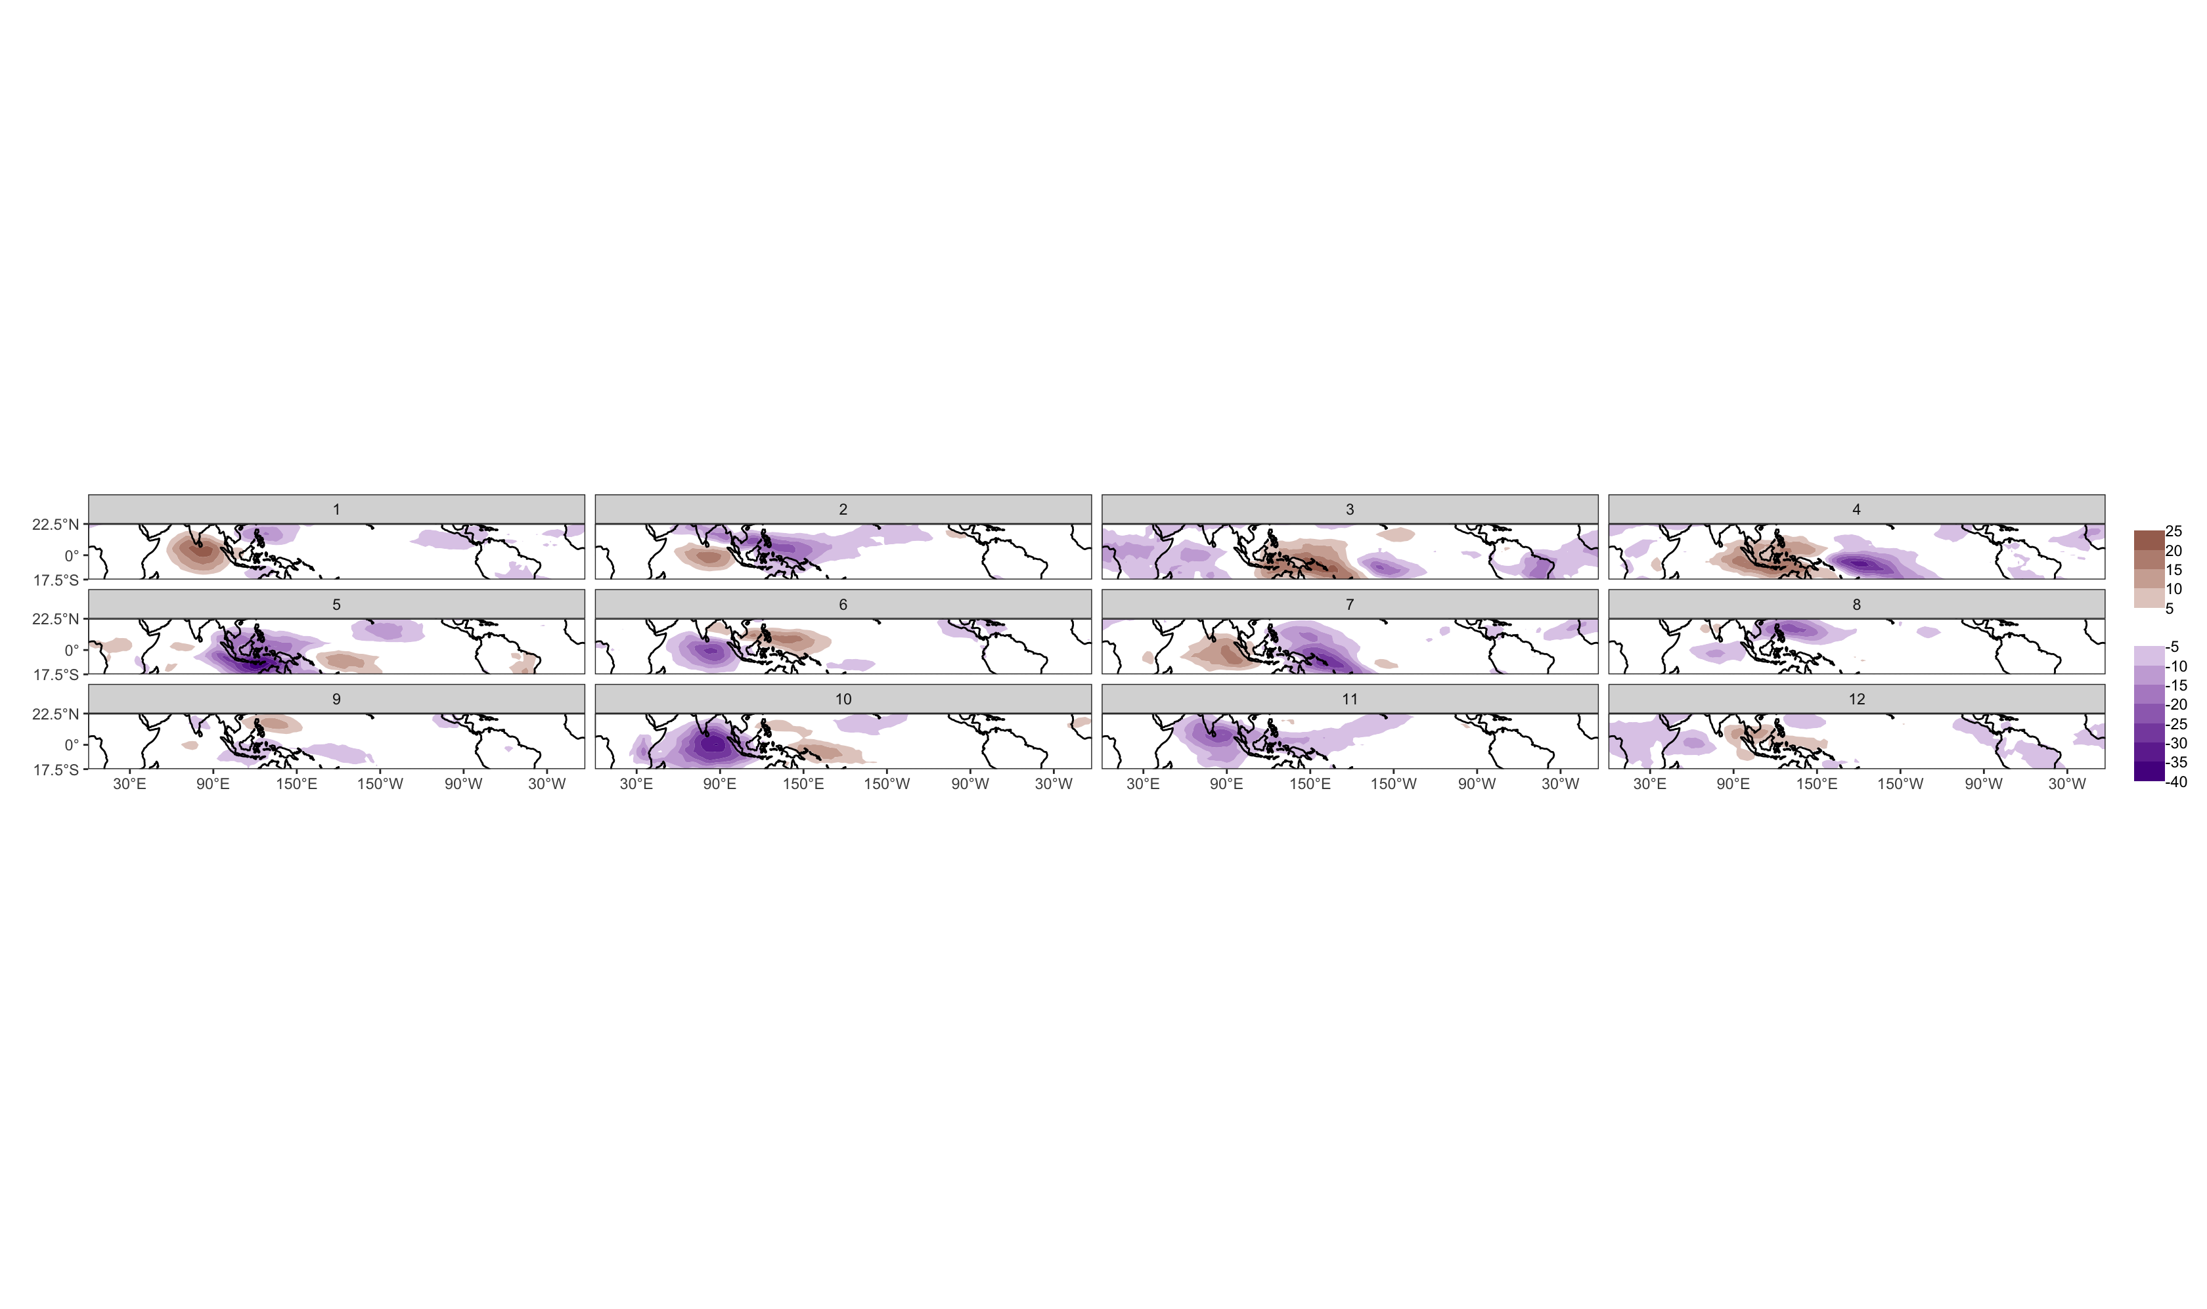
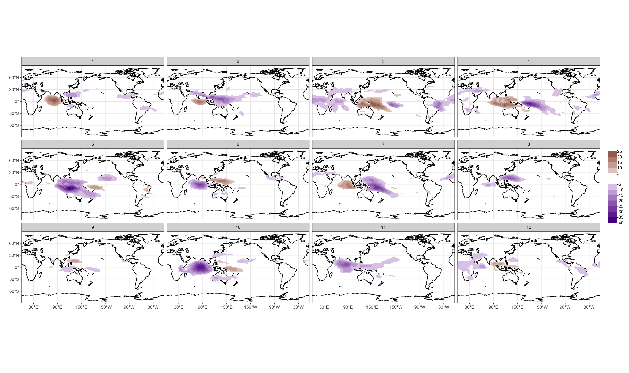
How to choose the optimal number for k?

Slide 20
Technique | Description
average silhouette width | Measures of how similar an object is to its own cluster (cohesion) compared to other clusters (separation). Closer to +1 is better
total within sum of square | measures the total variability of the observations within each cluster. Smaller is better
gap statistics | Indicates where the biggest jump in within-cluster distance occurred
library(factoextra)
fviz_nbclust(OLR, kmeans, method = ”silhouette")
fviz_nbclust(OLR, kmeans, method = ”wss")
fviz_nbclust(OLR, kmeans, method = "gap_stat")
Notes:
Tibshirani, R., G. Walther, and T. Hastie, 2000: Estimating the number of clusters in a dataset via the gap statistic. J. R. Statist. Soc. B, 63, 411–423, https://doi.org/10.1111/1467-9868.00293.
Rousseeuw, P. J., 1987: Silhouettes: A graphical aid to the interpretation and validation of cluster analysis. J. Comput. Appl. Math., 20, 53–65, https://doi.org/10.1016/0377-0427(87)90125-7.

Slide 21
Example of Application in Earth Sciences

Slide 22
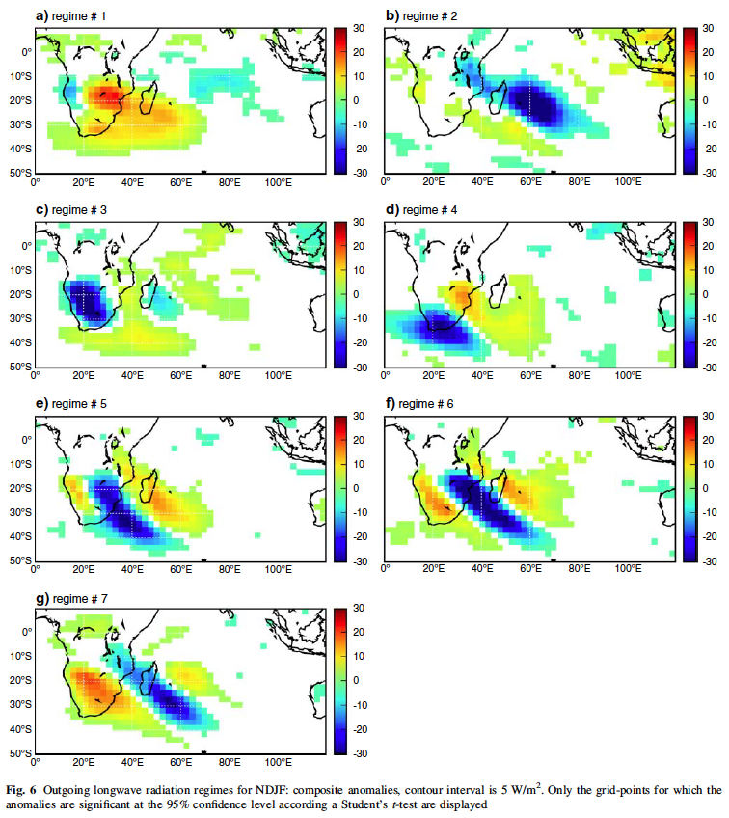
Fauchereau, N., B. Pohl, C. J. C. Reason, M. Rouault, and Y. Richard, 2009: Recurrent daily OLR patterns in the Southern Africa/Southwest Indian Ocean region, implications for South African rainfall and teleconnections. Clim. Dyn., 32, 575–591, https://doi.org/10.1007/s00382-008-0426-2.

Slide 23
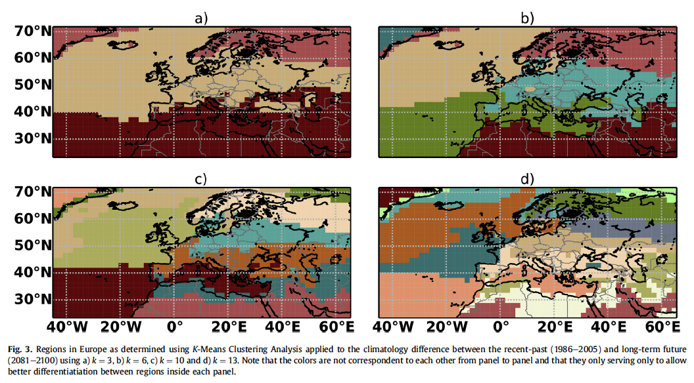
Carvalho, M. J., P. Melo-Gonçalves, J. C. Teixeira, and A. Rocha, 2016: Regionalization of Europe based on a K-Means Cluster Analysis of the climate change of temperatures and precipitation. Physics and Chemistry of the Earth, Parts A/B/C, 94, 22–28, https://doi.org/10.1016/j.pce.2016.05.001.

Slide 24
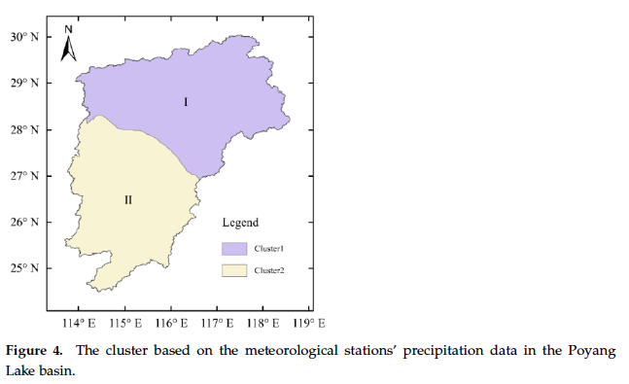
Lou, D., M. Yang, D. Shi, G. Wang, W. Ullah, Y. Chai, and Y. Chen, 2021: K-Means and C4.5 Decision Tree Based Prediction of Long-Term Precipitation Variability in the Poyang Lake Basin, China. Atmosphere, 12, 834, https://doi.org/10.3390/atmos12070834.

Slide 25
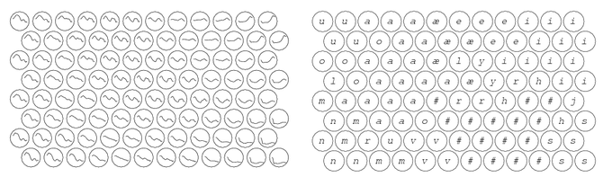
Another unsupervised artificial neural network, used to produce a low-dimensional representation of high-dimensional datasets
Developed by Prof. Teuvo Kohonen in the early 1980s
First application area of the SOM was speech recognition and speech-to-text transformation:
It follows the spatially ordered line detectors of von der Malsburg (1973) and the neural field model of Amari (1980)
System model composed of at two interacting subsystems of different nature: - competitive neural network - local synaptic plasticity of the neurons in learning modified by the network
Left: Models of acoustic spectra of Finnish phonemes, organized on an SOM
Right: Calibration of the models into phonemic classes
Notes:
Kohonen, T., 1982: Self-organized formation of topologically correct feature maps. Biol. Cybern., 43, 59–69, https://doi.org/10.1007/BF00337288.
von der Malsburg, C., 1973: Self-organization of orientation sensitive cells in the striate cortex. Kybernetik, 14, 85–100, https://doi.org/10.1007/BF00288907.
Amari, S., 1980: Topographic organization of nerve fields. Bulletin of Mathematical Biology, 42, 339–364, https://doi.org/10.1016/S0092-8240(80)80055-3.

Slide 26
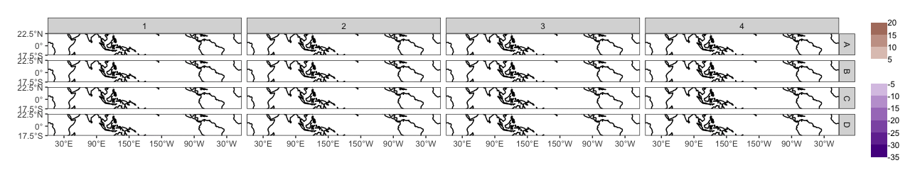
Random initialization
Deciding the dimension for the two-dimensional SOM array,
Initializing to random values,
Each node will finally represent a pattern of OLR anomalies in the study region.
4x4 Kohonen Map

Slide 27
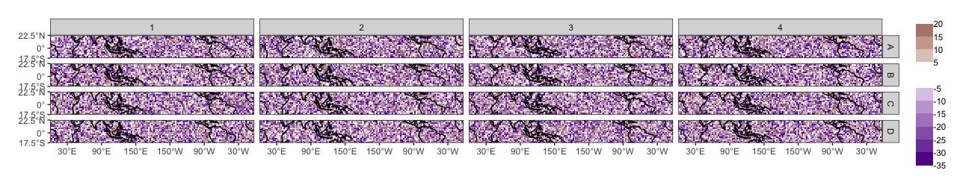
Random initialization
Deciding the dimension for the two-dimensional SOM array,
Initializing to random values,
Each node will finally represent a pattern of OLR anomalies in the study region.
4x4 Kohonen Map

Slide 28
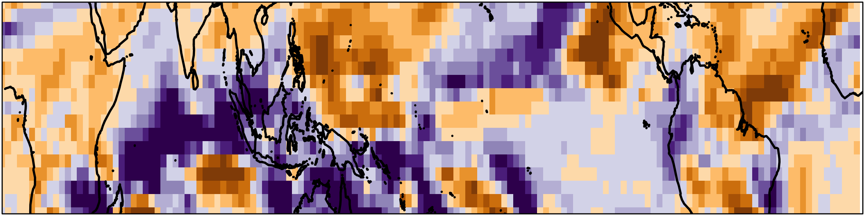

Input data
Larger initial learning rate (α) and neighborhood radius (r),
At each step in the training process, a node with the smallest Euclidean distance with the input data from 16 nodes is searched. This is called the best matching node:
Best matching node:
$$c=\arg{\min\left\{\left\|x−y_{ij}\right\|\right\}}$$
Euclidean distance
For step n, x(n) is an input data vector and y_{ij}(n) a reference vector of the Kohonen map

Slide 29
Input data
Larger initial learning rate (α) and neighborhood radius (r),
At each step in the training process, a node with the smallest distance with the input data from 16 nodes is searched. This is called the best matching node. This is called the “winner” node,
The winner node becomes the center of an update neighborhood ( ).
Notes:
Liu, Y., R. H. Weisberg, and C. N. K. Mooers, 2006: Performance evaluation of the self-organizing map for feature extraction. J. Geophys. Res., 111, C05018_1-C05018_14, https://doi.org/10.1029/2005JC003117.

Slide 30
Input data
Larger initial learning rate (α) and neighborhood radius (r),
At each step in the training process, a node with the smallest distance with the input data from 16 nodes is searched. This is called the best matching node. This is called the “winner” node,
The winner node becomes the center of an update neighborhood ( ).
After the training, the winner node and surrounding nodes, according to r, become like the input data. This process is repeated N times.
Notes:
Liu, Y., R. H. Weisberg, and C. N. K. Mooers, 2006: Performance evaluation of the self-organizing map for feature extraction. J. Geophys. Res., 111, C05018_1-C05018_14, https://doi.org/10.1029/2005JC003117.

Slide 31
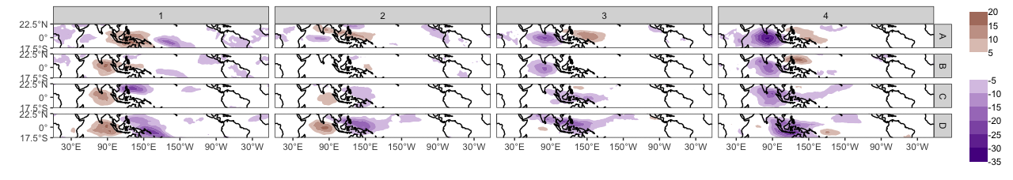
After a fine-tuning phase, with smaller learning rate and neighborhood radius, the randomized map...
… becomes the final map, with coherent spatial patterns of filtered OLR identified:

Slide 32
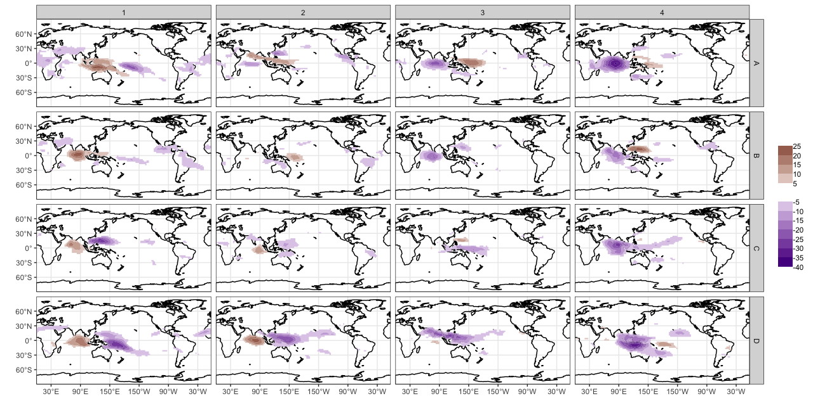
Kohonen map with 16 patterns of OLR anomalies, characteristic of input data
→ similar patterns nearby,
→ dissimilar patterns further apart.

Slide 33
Dimensions of the grid | Number of columns Number of rows
Topology | Rectangular Hexagonal
Neighborhood function | Bubble Gaussian
Radius of the neighborhood | Distance to define which node(s) to udate around the “winner” node.
Tuning length | Number of times the complete data set will be presented to the network.
Learning rate | Controls the size of weight vector in learning
Distance function | Sum of squares Euclidean

Slide 34
Example for a SOM in R using kohonen package
library(kohonen)
xdim <- 4 # Number of column
ydim <- 4 # Number of rows
n.centers <- xdim*ydim # Dimensions of the grid
som.grid <- somgrid(
xdim = xdim, # Number of column
ydim = ydim, # Number of rows
topo = "rect", # Topology
neighbourhood.fct = "gaussian” # Neighborhood function
)
som.out <- som(
OLR, # Matrix of data to cluster (time x space)
grid = som.grid, # Grid definition
rlen = 999, # Tuning length
alpha = c(0.05, 0.01), # Learning rate
radius <- c(0, 2), # Radius of the neighborhood
dist.fcts = "sumofsquares” # Distance function
)

Slide 35
Quantization error | Average squared distance between the data points and the map's prototypes to which they are mapped. Lower is better.
Percentage of explained variance | The share of total variance that is explained by the clustering. Higher is better.
Topographic error | Measures how well the topographic structure of the data is preserved on the map. Lower is better
Kaski-Lagus error | Combines aspects of the quantization and topographic error.
Sammon mapping | Represents the relative position of the final nodes to each others. Closer the map is to the desired topology, better the clustering is.
library(aweSOM)
somQuality(som = som.out, traindat = OLR)
Notes:
Kaski, S., and K. Lagus, 1996: Comparing self-organizing maps. Artificial Neural Networks — ICANN 96, C. Von der Malsburg, W. Von Seelen, J.C. Vorbrüggen, and B. Sendhoff, Eds., Lecture Notes in Computer Science, Berlin, Heidelberg, Springer, 809–814.
Bauer, H.-U., M. Herrmann, and T. Villmann, 1999: Neural maps and topographic vector quantization. Neural Networks, 12, 659–676, https://doi.org/10.1016/S0893-6080(99)00027-1.
Kiviluoto, K., 1996: Topology preservation in self-organizing maps. IEEE International Conference on Neural Networks, 1996, Vol. 1 of, IEEE International Conference on Neural Networks, 1996, 294–299 vol.1.
Sammon, J. W., 1969: A Nonlinear Mapping for Data Structure Analysis. IEEE T. Comput., C–18, 401–409, https://doi.org/10.1109/T-C.1969.222678.

Slide 36
Some Advices

Slide 37
Number of partitions:
Techniques available to help to decide the optimal number in k-means
But often not enough, so:
Try different number of clusters for k-means
Try different grid dimension/topology for SOM
Evaluate the quality of the partition
Other settings influencing the quality of the partition:
k-means:
“Hartigan-Wong” algorithm generally performs better with high-dimensional data
SOM:
Neighborhood function
Distance function
Learning rate
Tuning length

Slide 38
Example of Application

Slide 39
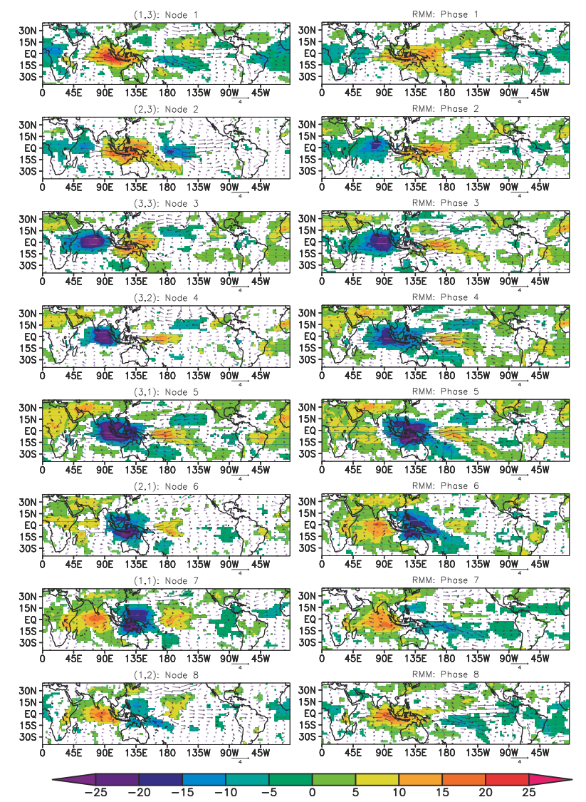
Chattopadhyay et al (2013)
Wheeler and Hendon (2004)
Chattopadhyay, R., A. Vintzileos, and C. Zhang, 2013: A description of the Madden–Julian oscillation based on a self-organizing map. J. Clim., 26, 1716–1732, https://doi.org/10.1175/JCLI-D-12-00123.1.
Wheeler, M. C., and H. H. Hendon, 2004: An all-season real-time multivariate MJO index: development of an index for monitoring and prediction. Mon. Weather Rev., 132, 1917–1932, https://doi.org/10.1175/1520-0493(2004)132<1917:AARMMI>2.0.CO;2.
(left) Composites of eight SOM nodes of OLR anomalies (colors; W·m⁻²) and wind vectors (m·s⁻¹) for November–April of 1979–2008.
(right) As in (left), but for RMM phase composites.

Slide 40
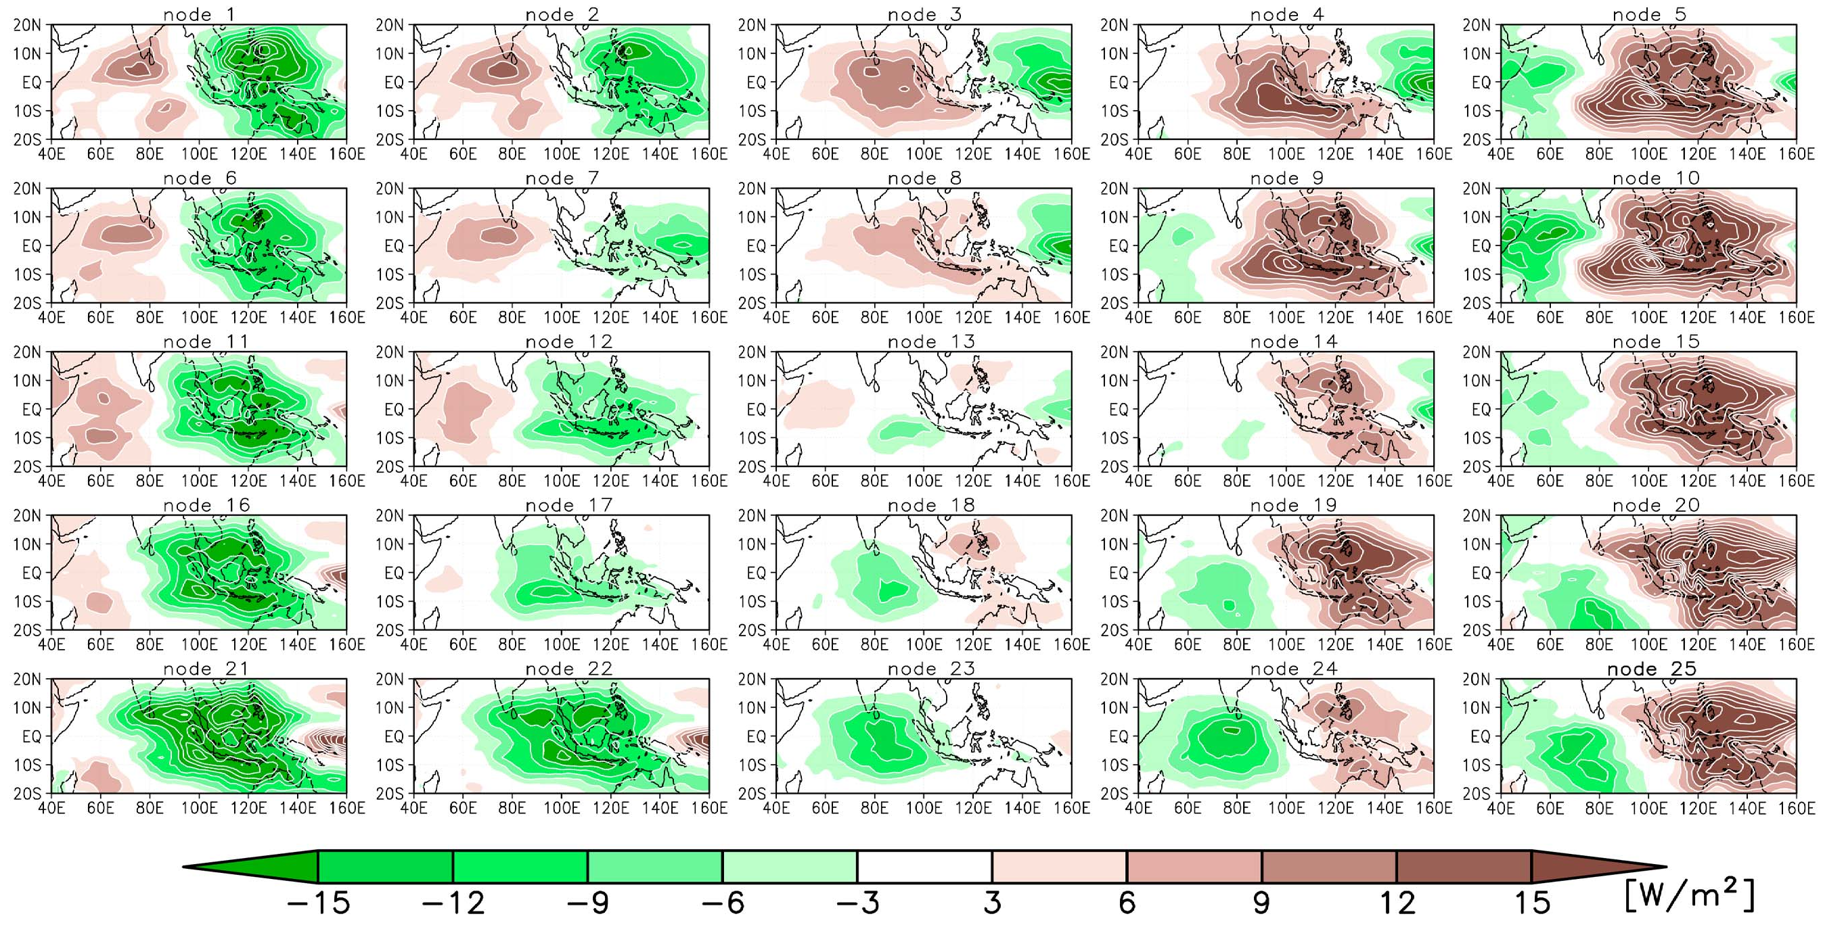
Daily OLR anomalies (40°E−160°E, 20°S−20°N) from 1 October to 31 March, for the period 1979–2009
Sakai, K., R. Kawamura, and Y. Iseri, 2010: ENSO-induced tropical convection variability over the Indian and western Pacific oceans during the northern winter as revealed by a self-organizing map. J. Geophys. Res., 115, https://doi.org/10.1029/2010JD014415.

Slide 41
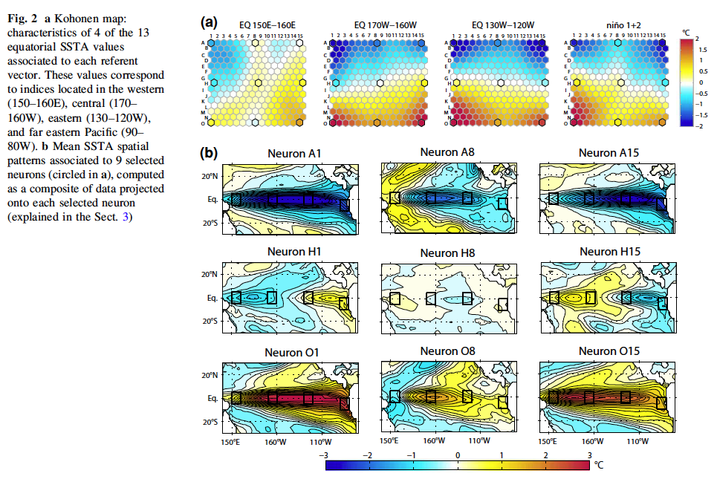
Leloup, J., M. Lengaigne, and J.-P. Boulanger, 2008: Twentieth century ENSO characteristics in the IPCC database. Clim. Dyn., 30, 277–291, https://doi.org/10.1007/s00382-007-0284-3.

Slide 42
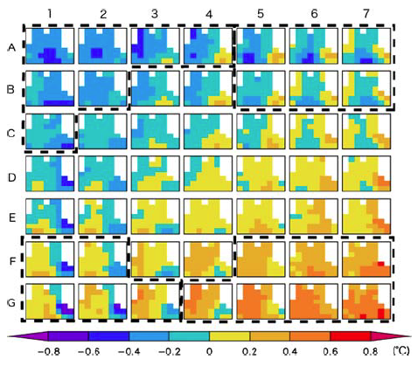
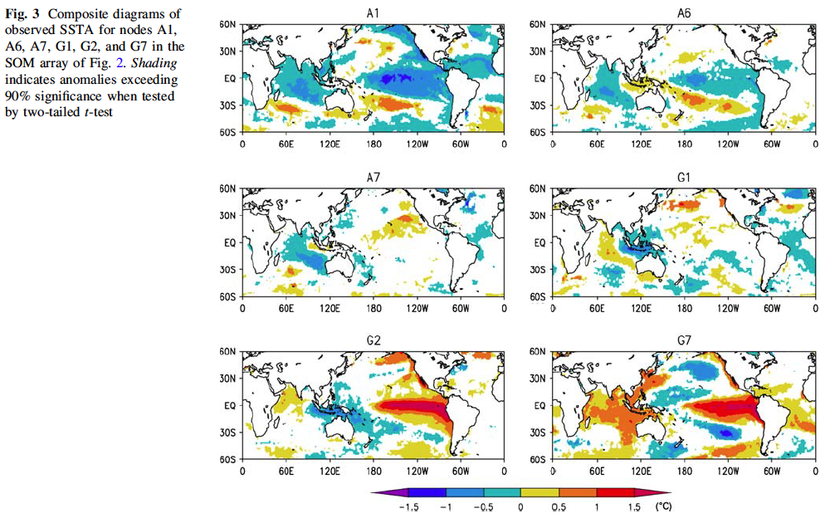
Tozuka, T., J.-J. Luo, S. Masson, and T. Yamagata, 2008: Tropical Indian Ocean variability revealed by self-organizing maps. Clim. Dyn., 31, 333–343, https://doi.org/10.1007/s00382-007-0356-4.

Slide 43
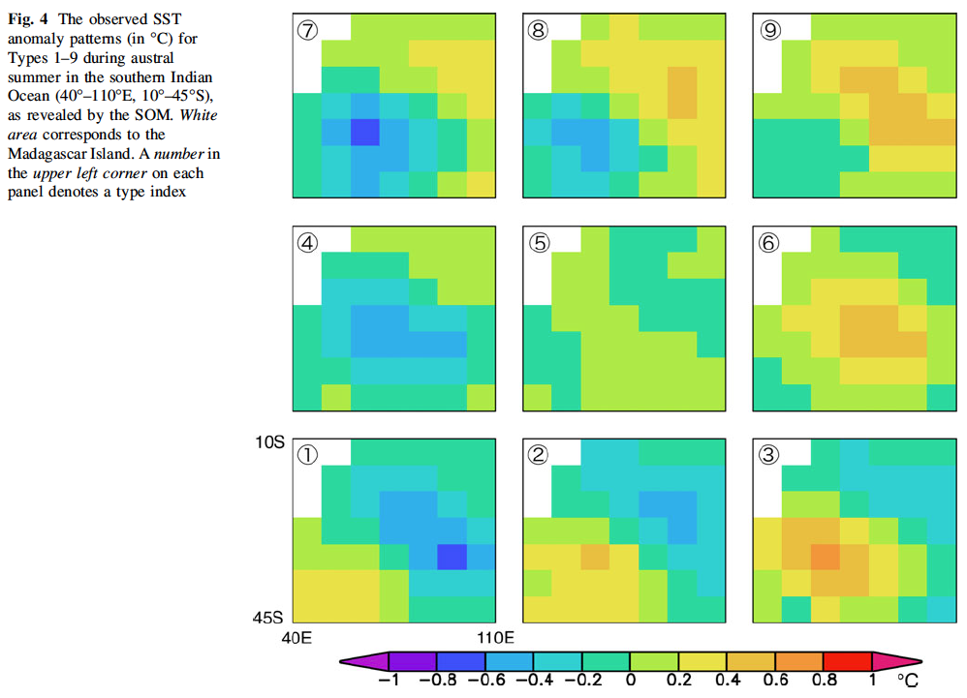
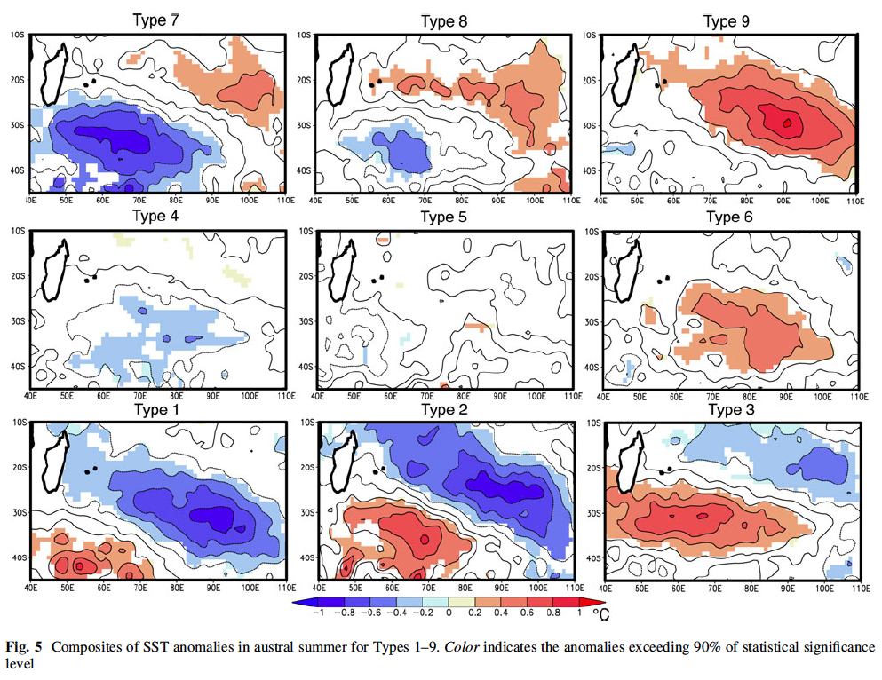
Morioka, Y., T. Tozuka, and T. Yamagata, 2010: Climate variability in the southern Indian Ocean as revealed by self-organizing maps. Clim. Dyn., 35, 1059–1072, https://doi.org/10.1007/s00382-010-0843-x.

Slide 44
Regression

Slide 45
Learning a general model (=relationship) from data
Making forecasts from this model

Slide 46
Regression Methods

Slide 47
Learning a general model (=relationship) from data
Making forecasts from this model
Linear Regression
Quantile Regression
Logistic Regression
Poisson Regression
Bayesian Linear Regression
Decision Tree/Forest Regression
Neural Network Regression
Boosted Decision Tree Regression

Slide 48
Linear Regression
Assumes a linear relationship between inputs X and output y; by minimizing the residual sum of squares (RSS)
Quantile Regression
Extension of the linear regression;
Estimates the conditional quantiles rather than the mean
Logistic Regression
Predicts the category of individuals;
Estimates the probability of category membership;
Poisson Regression
Predicts the count of individuals (i.e., the response variable following a Poisson distribution)

Slide 49
Bayesian Linear Regression BART machine
Considers various plausible explanations for how the data were generated;
Makes predictions using all possible regression weights, weighted by
their probability distribution.
Decision Tree/Forest Regression random forest
Fits several decision tree classifiers (which learn simple decision rules inferred from the data features) on various sub-samples of the dataset and uses averaging to improve the predictive accuracy
Boosted Decision Tree Regression XGBoost, CatBoost
Builds a strong classifier from several weak classifiers (typically decision trees), through iteration
Notes:
Previous regressions are said “Frequentist” i.e., the most plausible value of a paramater is used
In Bayesian perspective, a whole probability distribution for the unknown parameter is produced
Boosted Decision Tree: anomalies from precedent trees

Slide 50
Neural Network Regression (Multilayer Perceptron)
Mimics the human brain and how the neurons interact with each other, how they are activated and how they learn
Support-Vector Machine
Minimizes the coefficients in order to reach an acceptable error;
Different kernel functions (i.e., a pattern analysis to identify recurrent relationship in datasets) are available
K-Nearest Neighbors
Uses feature similarity, i.e., averages the observations in the same neighborhood to predict the outcome

Slide 51
Predictors
Regression Model
Machine Learning
Prediction
Outcome

Slide 52
Feature Selection
Predictors
Regression Model
Machine Learning
Prediction
Outcome

Slide 53
Feature Selection
Training Subset
Predictors
Regression Model
Machine Learning
Prediction
Outcome
Evaluation
Validation Subset
Several ML algortihms, each repeated several time, and evaluated to choose the most skillful one

Slide 54
Feature Selection

Slide 55
Technique | Description
Multicollinearity Check | Determines highly correlated variables, to remove collinearities
Variance Inflation Factor | Measure of the amount of multicollinearity in a set of multiple regression variables
Boruta | Iteratively compares the importance of attributes with their shuffled versions of the original attribute. All original attributes that have smaller importance than the shuffled version are dropped. Shuffling are re-created in each iteration. Random Forest algorithm is used to provide the variable importance measure
Genetic Algorithms | Machine learning search techniques inspired by Darwinian evolutionary models. Appropriate for finding solutions that require efficient searching of a subset of features to find combinations that are near optimal for solving high-dimensional regression

Slide 56
Some Advices

Slide 57
Splitting the data to improve the robustness of the model:
Training subset
Validation subset
Evaluation subset
During the training phase, using a resampling can help to reduce the overfitting:
cross-validation
leave-one-out
k-fold
boostrapping
time slices
A random search of the hyperparameters can be more efficient than a systematic search through a defined range of values

Slide 58
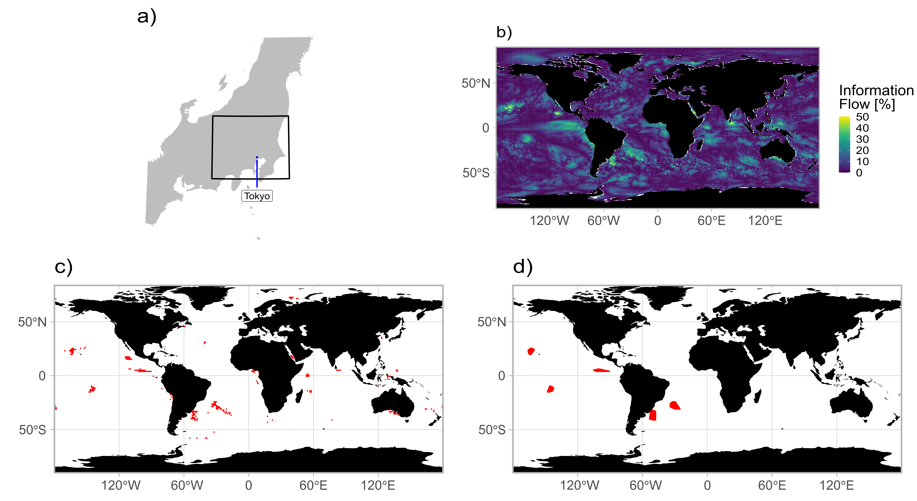
Utilizes SST forecast by SINTEX-F2 to provide predictors of the SAT in Kantō region
Selected region of SST as potential predictor
Oettli, P., M. Nonaka, I. Richter, H. Koshiba, Y. Tokiya, I. Hoshino, and S. K. Behera, 2022: Combining Dynamical and Statistical Modeling to Improve the Prediction of Surface Air Temperatures 2 Months in Advance: A Hybrid Approach. Front. Clim., 4, https://doi.org/10.3389/fclim.2022.862707.

Slide 60
Selection of all potential predictors
Feature selection (or not)
Machine learning

Slide 61
Type | Acronym | Meaning
Neural Network | SLP | Single-Layer Perceptron (1 HL)
 | MLP | Multi-Layer Perceptron (3 HL)
Random Forest | RF | Random Forest
Support Vector Machine | SVML | Support Vector Machine Linear Kernel
 | SVMR | Support Vector Machine Radial Kernel
Boosting | XGBL | eXtreme Gradient Boosting Linear
 | XGBT | eXtreme Gradient Boosting Tree-based
 | CBST | CatBoost
Bayesian | BART | BARTmachine

Slide 62
Selection of all potential predictors
Feature selection (or not)
Machine learning
Optimization
Hybrid System

Slide 63
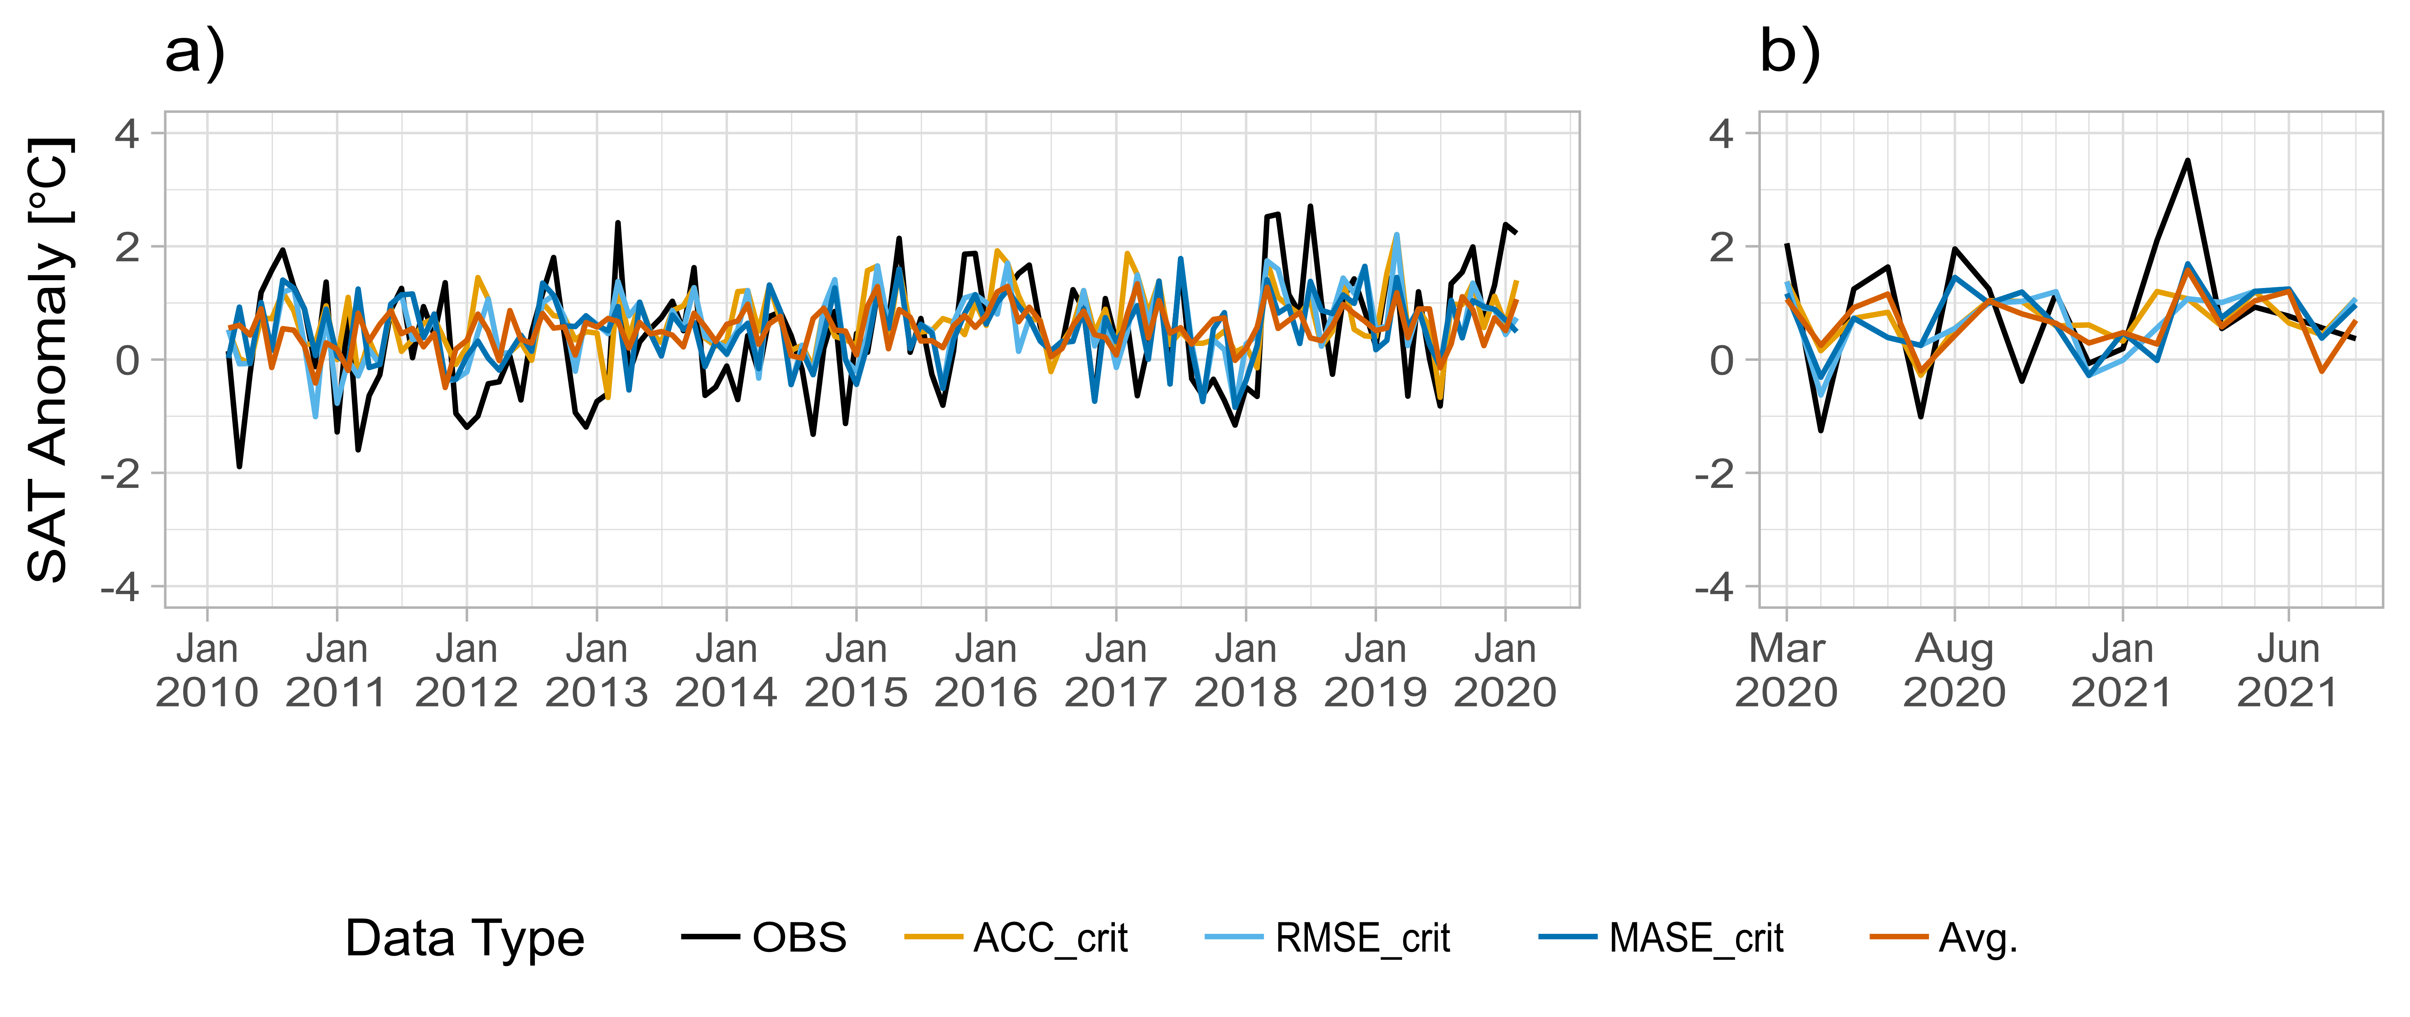
Validation subset
Evaluation subset

Slide 64
Pseudocode for caret approach in R
# Algorithm parameters
tgrid <- data.frame(
[…]
)
# Controlling the computational nuances of the train function
TrC_boot632 <- trainControl(
[…]
)
# Fitting the model
algorithm.out <- train(
[…]
)
# Applying model to data
predict(algorithm.out, validation subset)

Slide 65
tgrid <- data.frame(
size = sample(1:20, size = tuneLength, replace = TRUE)
, decay = 10^runif(tuneLength, min = -5, 1)
)
TrC_boot632 <- trainControl(
method = "boot632" # Resampling method
, search = "grid" # Pickup parameter in user-defined parameters
, number = number # Number of resampling iterations
, summaryFunction = defaultSummary # A function to compute performance metrics across resamples
, savePredictions = "all"
, returnResamp = "all"
, allowParallel = TRUE
)
nnet.out <-
train(x = x.Calib.DATA
, y = y.Calib.DATA
, trControl = TrC_boot632
, tuneGrid = tgrid # Data frame of random parameters defined above
, method = "nnet" # Name of the algorithm
, metric = "RMSE" # Name of the metric to find the best model
, maximize = FALSE
, preProcess = preProcess
, linout = TRUE
, MaxNWts = 84581
)
predict(nnet.out, x.Valid.DATA) # Prediction on validation subset
Example for a artificial neural network in R using caret package

Slide 66
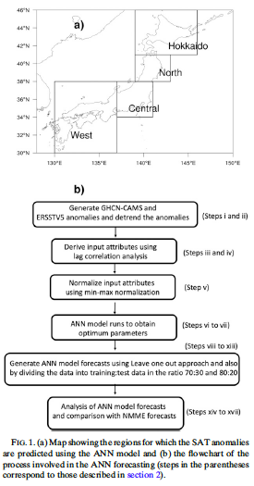
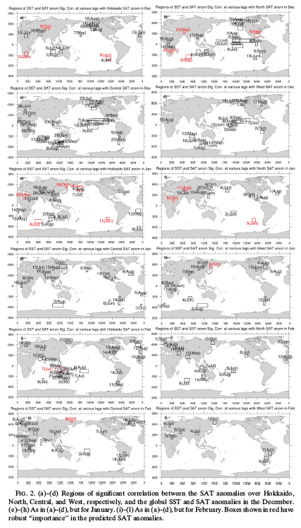
Ratnam, J. V., H. A. Dijkstra, and S. K. Behera, 2020: A machine learning based prediction system for the Indian Ocean Dipole. Sci Rep, 10, 284, https://doi.org/10.1038/s41598-019-57162-8.

Slide 67
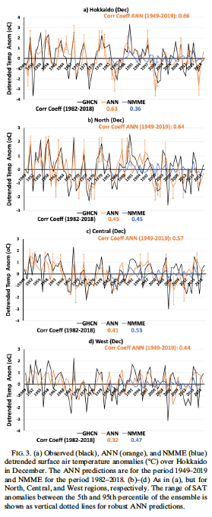
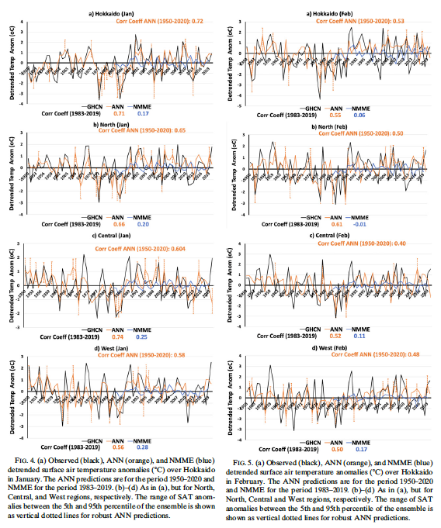
Ratnam, J. V., H. A. Dijkstra, and S. K. Behera, 2020: A machine learning based prediction system for the Indian Ocean Dipole. Sci Rep, 10, 284, https://doi.org/10.1038/s41598-019-57162-8.

Slide 68
Deep Learning
Notes:
ANN is used in ML, but is also an important component of DL

Slide 69
0-D Tensor
1-D Tensor
2-D Tensor
N-D Tensor

Slide 70
Basic structure of an artificial neural network
b
i | Input layer | Inputs
o | Output layer | Targets
h | Hidden layer | Transformation of original inputs Invisible outputs, hence “hidden”
b | Bias | Allows the activation function to shift to the left or to the right
w | Weight | Steepness of the activation function
i
h
o
Feedforward
Neuron
Bias neuron
W

Slide 71
Basic structure of an artificial neural network
b
i
h₁
h₂
h_{n}
o
”Deep Learning”
…
depth

Slide 72
Input X
Chollet, F., 2018: Deep learning with Python. Manning Publications Co, 361 pp.
Layer (data transformation)
Weights
Layer (data transformation)
Weights
Predictions Y’
Notes:
How deep learning works

Slide 73
Input X
Chollet, F., 2018: Deep learning with Python. Manning Publications Co, 361 pp.
Layer (data transformation)
Weights
Layer (data transformation)
Weights
Finding the right values to improve Y’
Predictions Y’

Slide 74
Input X
Chollet, F., 2018: Deep learning with Python. Manning Publications Co, 361 pp.
Layer (data transformation)
Weights
Layer (data transformation)
Weights
Predictions Y’
True targets Y
Loss function
Loss score

Slide 75
Input X
Chollet, F., 2018: Deep learning with Python. Manning Publications Co, 361 pp.
Layer (data transformation)
Weights
Layer (data transformation)
Weights
Predictions Y’
True targets Y
Loss function
Quality of the network’s output
Loss score

Slide 76
Input X
Chollet, F., 2018: Deep learning with Python. Manning Publications Co, 361 pp.
Layer (data transformation)
Weights
Layer (data transformation)
Weights
Predictions Y’
True targets Y
Loss function
Optimizer
Loss score

Slide 77
Input X
Chollet, F., 2018: Deep learning with Python. Manning Publications Co, 361 pp.
Layer (data transformation)
Weights
Layer (data transformation)
Weights
Predictions Y’
True targets Y
Backpropagation
Weights update
Loss function
Optimizer
Loss score

Slide 78
i
h₁
h₂
o
Densely (or fully) connected network

Slide 79
Fully Connected
Input
Convolution
Pooling
Convolutional Neural Network

Slide 80


The fundamental difference between a densely connected layer and a convolution layer is this: dense layers learn global patterns in their input feature space[…], whereas convolution layers learn local patterns.
Chollet, F., and J. J. Allaire, 2018: Deep learning with R. Manning Publications Co, 335 pp.
Because these are local features, they can be found anywhere in a “picture”;
Learning is hierarchicel, each convolution being dedicated to learn different charaterictics of the “picture” (i.e., edges, shapes,…)
Notes:
I use “picture” as a general term because convets where first develops to retrieve patterns in pictures. We will see soon how it applies to earth sciences

Slide 81

input (2-D tensor)
97 | 90 | 21 | 4 | 53 | 90
39 | 5 | 21 | 49 | 56 | 65
52 | 94 | 72 | 21 | 3 | 87
19 | 29 | 40 | 34 | 7 | 82
50 | 93 | 99 | 1 | 2 | 61
24 | 67 | 54 | 72 | 6 | 54
The kernel is used to extract feature map from the input, via a dot product, then the pooling reduces the amount of information
kernel (convolutional filter)
1 | 1 | 1
1 | 1 | 1
1 | 1 | 1
pooling (window and function)
$$\max{(x)}$$

Slide 82
97 | 90 | 21 | 4 | 53 | 90
39 | 5 | 21 | 49 | 56 | 65
52 | 94 | 72 | 21 | 3 | 87
19 | 29 | 40 | 34 | 7 | 82
50 | 93 | 99 | 1 | 2 | 61
24 | 67 | 54 | 72 | 6 | 54
97 | 90 | 21 | 4 | 53 | 90
39 | 5 | 21 | 49 | 56 | 65
52 | 94 | 72 | 21 | 3 | 87
19 | 29 | 40 | 34 | 7 | 82
50 | 93 | 99 | 1 | 2 | 61
24 | 67 | 54 | 72 | 6 | 54
(97*1)+(90*1)+(21*1) +(39*1)+(5*1)+(21*1) +(52*1)+(94*1)+(72*1)
= 491
1 | 1 | 1
1 | 1 | 1
1 | 1 | 1

Slide 83
97 | 90 | 21 | 4 | 53 | 90
39 | 5 | 21 | 49 | 56 | 65
52 | 94 | 72 | 21 | 3 | 87
19 | 29 | 40 | 34 | 7 | 82
50 | 93 | 99 | 1 | 2 | 61
24 | 67 | 54 | 72 | 6 | 54
97 | 90 | 21 | 4 | 53 | 90
39 | 5 | 21 | 49 | 56 | 65
52 | 94 | 72 | 21 | 3 | 87
19 | 29 | 40 | 34 | 7 | 82
50 | 93 | 99 | 1 | 2 | 61
24 | 67 | 54 | 72 | 6 | 54
(90*1)+(21*1)+(4*1) +(5*1)+(21*1)+(49*1) +(94*1)+(72*1)+(21*1)
= 377
1 | 1 | 1
1 | 1 | 1
1 | 1 | 1
This convolution is a strided convolution with stride 1
Notes:
The kernel is moved over the tensor in both directions. The stride defines the distance between two successive windows. In the example below, the distance between successive windows is one grid point in both directions. So the stride is equal to 1

Slide 84
97 | 90 | 21 | 4 | 53 | 90
39 | 5 | 21 | 49 | 56 | 65
52 | 94 | 72 | 21 | 3 | 87
19 | 29 | 40 | 34 | 7 | 82
50 | 93 | 99 | 1 | 2 | 61
24 | 67 | 54 | 72 | 6 | 54
97 | 90 | 21 | 4 | 53 | 90
39 | 5 | 21 | 49 | 56 | 65
52 | 94 | 72 | 21 | 3 | 87
19 | 29 | 40 | 34 | 7 | 82
50 | 93 | 99 | 1 | 2 | 61
24 | 67 | 54 | 72 | 6 | 54
1 | 1 | 1
1 | 1 | 1
1 | 1 | 1

Slide 85
input
97 | 90 | 21 | 4 | 53 | 90
39 | 5 | 21 | 49 | 56 | 65
52 | 94 | 72 | 21 | 3 | 87
19 | 29 | 40 | 34 | 7 | 82
50 | 93 | 99 | 1 | 2 | 61
24 | 67 | 54 | 72 | 6 | 54
feature map
491 | 377 | 300 | 428
371 | 365 | 303 | 404
548 | 483 | 279 | 298
475 | 489 | 315 | 319
kernel
1 | 1 | 1
1 | 1 | 1
1 | 1 | 1

Slide 86
input
97 | 90 | 21 | 4 | 53 | 90
39 | 5 | 21 | 49 | 56 | 65
52 | 94 | 72 | 21 | 3 | 87
19 | 29 | 40 | 34 | 7 | 82
50 | 93 | 99 | 1 | 2 | 61
24 | 67 | 54 | 72 | 6 | 54
feature map
491 | 377 | 300 | 428
371 | 365 | 303 | 404
548 | 483 | 279 | 298
475 | 489 | 315 | 319
491
kernel
1 | 1 | 1
1 | 1 | 1
1 | 1 | 1
pooling (window and function)
$$\max{(x)}$$

Slide 87
input
97 | 90 | 21 | 4 | 53 | 90
39 | 5 | 21 | 49 | 56 | 65
52 | 94 | 72 | 21 | 3 | 87
19 | 29 | 40 | 34 | 7 | 82
50 | 93 | 99 | 1 | 2 | 61
24 | 67 | 54 | 72 | 6 | 54
feature map
491 | 377 | 300 | 428
371 | 365 | 303 | 404
548 | 483 | 279 | 298
475 | 489 | 315 | 319
428
kernel
1 | 1 | 1
1 | 1 | 1
1 | 1 | 1
pooling (window and function)
$$\max{(x)}$$
Notes:
The poolinf is moved over the feature map in both directions. In the example below, the distance between successive windows is two grid points in both directions. So the stride is equal to 2

Slide 88

”valid” extraction
97 | 90 | 21 | 4 | 53 | 90
39 | 5 | 21 | 49 | 56 | 65
52 | 94 | 72 | 21 | 3 | 87
19 | 29 | 40 | 34 | 7 | 82
50 | 93 | 99 | 1 | 2 | 61
24 | 67 | 54 | 72 | 6 | 54
491 | 377 | 300 | 428
371 | 365 | 303 | 404
548 | 483 | 279 | 298
475 | 489 | 315 | 319
1 | 1 | 1
1 | 1 | 1
1 | 1 | 1
$$\max{(x)}$$
491 | 428
548 | 319
Notes:
“valid” means only valid window locations will be used, hence the feature map being smaller than the input

Slide 89
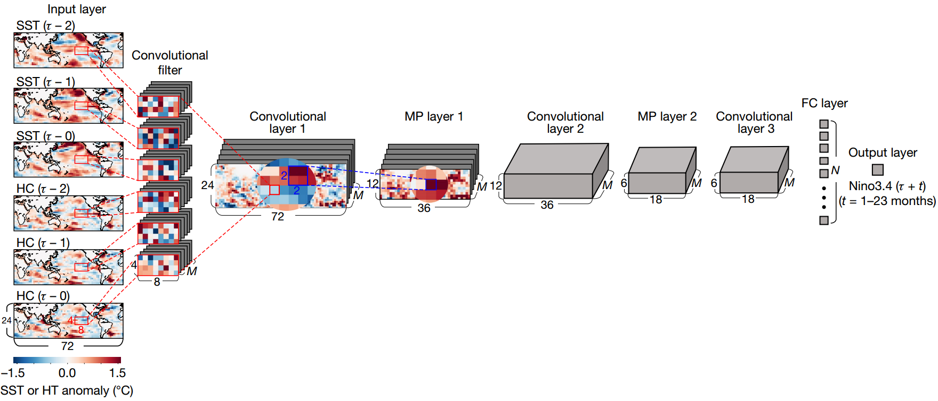
Ham, Y.-G., J.-H. Kim, and J.-J. Luo, 2019: Deep learning for multi-year ENSO forecasts. Nature, 1–5, https://doi.org/10.1038/s41586-019-1559-7.

Slide 90
Input data: 2961x72x24x6
Channels = (2x3) Time lags
Height = 24 Latitudes
Sample = 2961 Time steps
Width = 72 Longitudes

Slide 91
M = number of filters
i.e., different ways of extracting features from an input
Notes:
Because 1 filter is not enough to capture all the existing features, we need a repetition of filtering performed in parallel. The output of the convolutional layer 1 is the same size (apart M) than the input. This means padding as been use before the extraction.

Slide 92
”same” extraction, using padding
0 | 0 | 0 | 0 | 0 | 0 | 0 | 0
0 | 97 | 90 | 21 | 4 | 53 | 90 | 0
0 | 39 | 5 | 21 | 49 | 56 | 65 | 0
0 | 52 | 94 | 72 | 21 | 3 | 87 | 0
0 | 19 | 29 | 40 | 34 | 7 | 82 | 0
0 | 50 | 93 | 99 | 1 | 2 | 61 | 0
0 | 24 | 67 | 54 | 72 | 6 | 54 | 0
0 | 0 | 0 | 0 | 0 | 0 | 0 | 0
231 | 273 | 190 | 204 | 317 | 264
377 | 491 | 377 | 300 | 428 | 354
238 | 371 | 365 | 303 | 404 | 300
337 | 548 | 483 | 279 | 298 | 242
282 | 475 | 489 | 315 | 319 | 212
234 | 387 | 386 | 234 | 196 | 123
1 | 1 | 1
1 | 1 | 1
1 | 1 | 1
491 | 377 | 428
548 | 483 | 404
475 | 489 | 319
$$\max{(x)}$$
Notes:
“same” means padding is used to ensure the size of the feature map is equal to the size of the input (6x6).

Slide 93
Notes:
Another convolutional + pooling are added, followed by a last convolutional layer

Slide 94
N = number of units i.e., the nuber of nodes in the hidden layer
Notes:
The convolutional process is connected to a densely connected layer in order to perform the prediction

Slide 95
model <- keras_model_sequential()
model %>%
layer_conv_2d(kernel_size = c(8L, 4L),
filter = M,
activation = "tanh",
strides = strd_size,
padding = "same",
input_shape = c(xdim, ydim, zdim),
data_format = "channels_last") %>%
layer_max_pooling_2d(pool_size = pl_size,
data_format = "channels_last") %>%
layer_conv_2d(kernel_size = c(4L, 2L),
filter = M,
activation = "tanh",
strides = strd_size,
padding = "same",
data_format = "channels_last") %>%
layer_max_pooling_2d(pool_size = pl_size,
data_format = "channels_last") %>%
layer_conv_2d(kernel_size = c(4L, 2L),
filter = M,
activation = "tanh",
strides = strd_size,
padding = "same",
data_format = "channels_last") %>%
layer_flatten() %>%
layer_dense(units = N, activation = "tanh") %>%
layer_dense(units = 1)
Notes:
Creating the model with keras in R

Slide 96
Layer (type) Output Shape Param #
=========================================================================================================================
conv2d_2 (Conv2D) (None, 72, 24, M) ((8x4x6)+1)xM
max_pooling2d_1 (MaxPooling2D) (None, 36, 12, M) 0
conv2d_1 (Conv2D) (None, 36, 12, M) ((4x2xM)+1)xM
max_pooling2d (MaxPooling2D) (None, 18, 6, M) 0
conv2d (Conv2D) (None, 18, 6, M) ((4x2xM)+1)xM
flatten (Flatten) (None, 3240) 0
dense_1 (Dense) (None, N) ((18x6xM)+1)xN
dense (Dense) (None, 1) N+1
=========================================================================================================================
Notes:
Summary of model created by keras

Slide 97
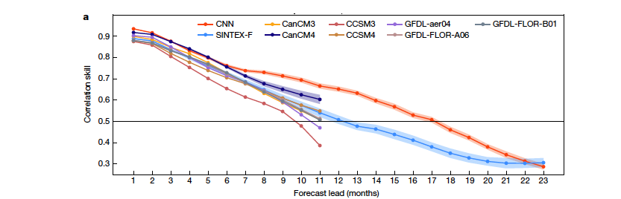
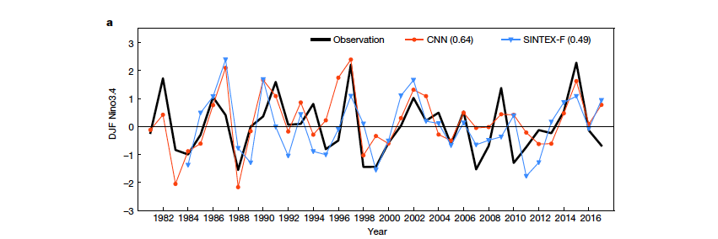

Slide 98
In order to get access to a much richer hypothesis space that would benefit from deep representations, you need a non-linearity, or activation function.
Chollet, F., and J. J. Allaire, 2018: Deep learning with R. Manning Publications Co, 335 pp.
In other words, introducing non-linearity by transforming the data between hidden layers
Important choice, which define how the network will learn from the input

Slide 99
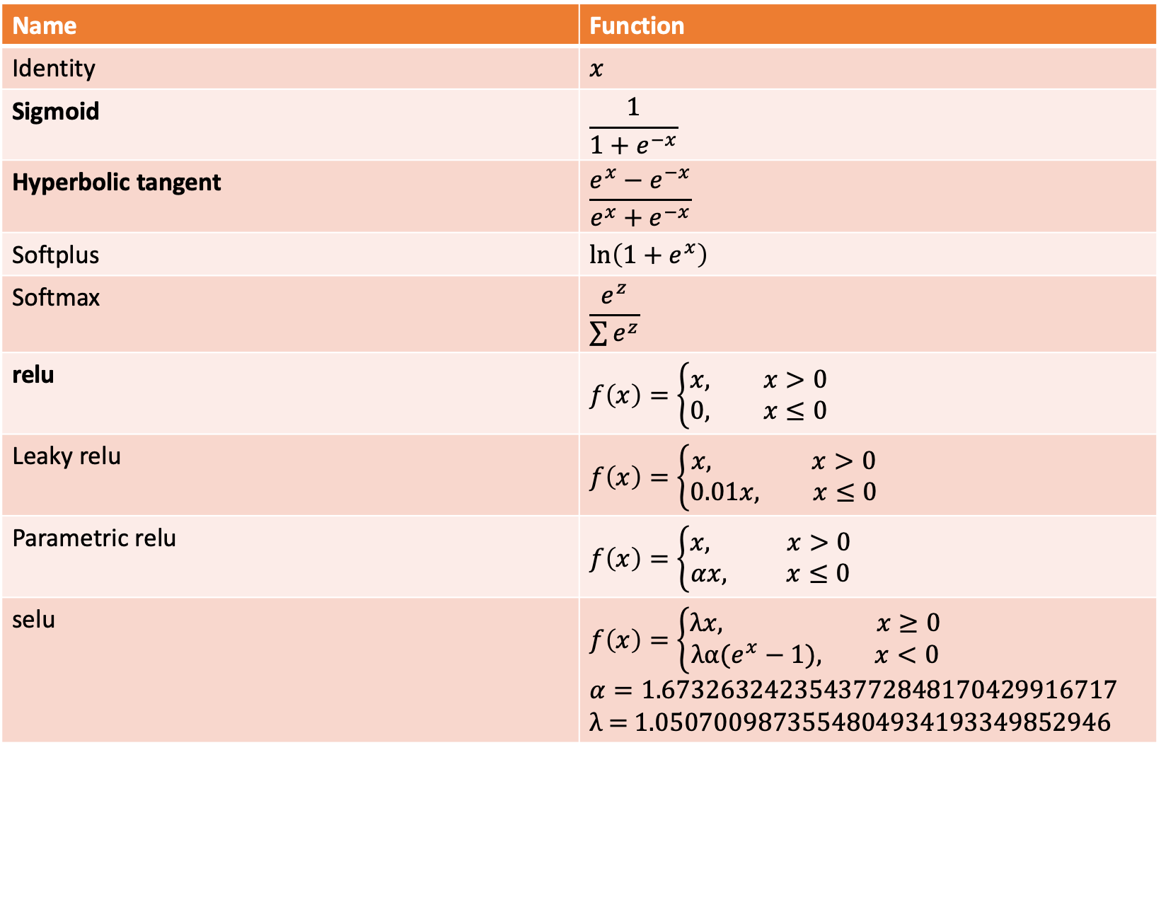
Name | Function
Identity | $$x$$
Sigmoid | $$\frac{1}{1+e^{−x}}$$
Hyperbolic tangent | $$\frac{e^{x}−e^{−x}}{e^{x}+e^{−x}}$$
Softplus | $$\ln\left(1+e^{x}\right)$$
Softmax | $$\frac{e^{z}}{\sum{e^{z}}}$$
relu | $$f\left(x\right)=\left\{\begin{aligned}x, x>0 \\ 0, x≤0\end{aligned}\right.$$
Leaky relu | $$f\left(x\right)=\left\{\begin{aligned}x, x>0 \\ 0.01x, x≤0\end{aligned}\right.$$
Parametric relu | $$f\left(x\right)=\left\{\begin{aligned}x, x>0 \\ αx, x≤0\end{aligned}\right.$$
selu | $$f\left(x\right)=\left\{\begin{aligned}λx, x≥0 \\ λα(e^{x}−1), x<0\end{aligned}\right.$$ $$α=\text{1.6732632423543772848170429916717}$$ λ = 1.0507009873554804934193349852946

Slide 100
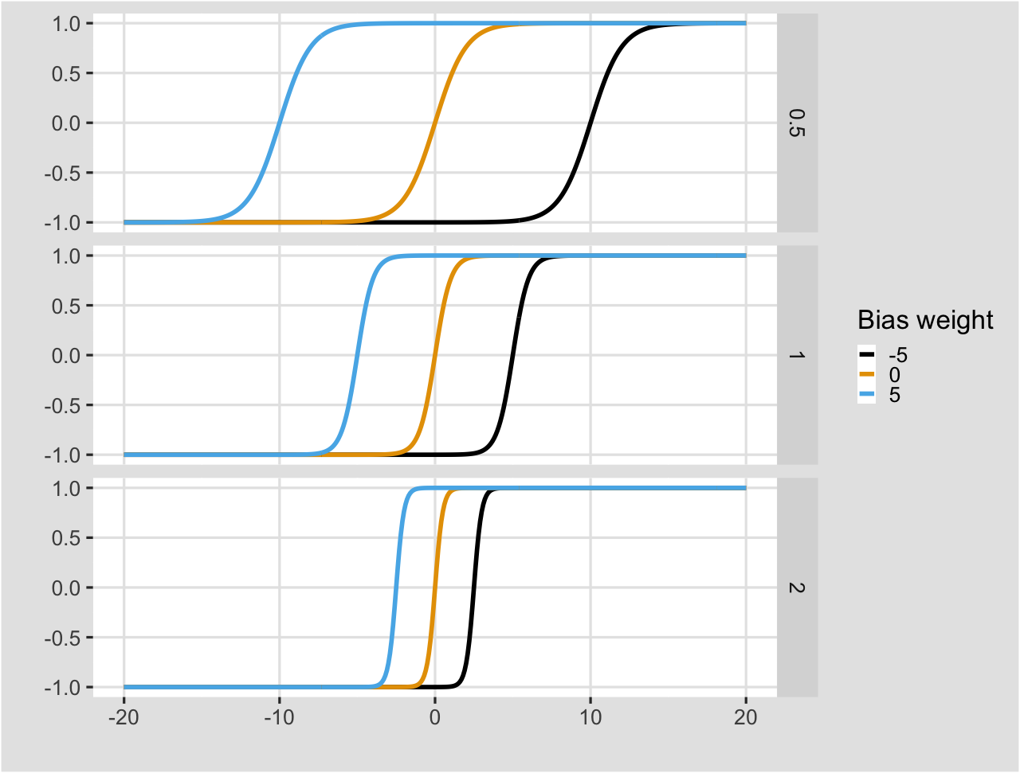


tanh = $\frac{e^{x}−e^{−x}}{e^{x}+e^{−x}}$
i
$$tanh(i∗w_{0}+b∗w_{1})$$
w₀
w₁
b
Notes:
Bias helps in controlling the value at which activation function will trigger.

Slide 101
The quantity that will be minimized during training. It represents a measure of success for the task at hand.
Chollet, F., and J. J. Allaire, 2018: Deep learning with R. Manning Publications Co, 335 pp.
It represents a measure of success

Slide 102
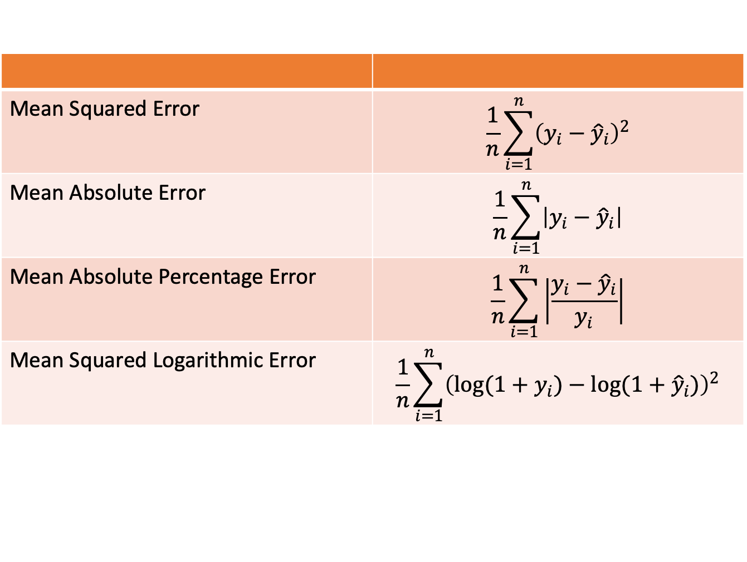
Mean Squared Error | $$\frac{1}{n}\sum_{i=1}^{n}{{\left(y_{i}−{\hat{y}}_{i}\right)}^{2}}$$
Mean Absolute Error | $$\frac{1}{n}\sum_{i=1}^{n}{\left|y_{i}−{\hat{y}}_{i}\right|}$$
Mean Absolute Percentage Error | $$\frac{1}{n}\sum_{i=1}^{n}{\left|\frac{y_{i}−{\hat{y}}_{i}}{y_{i}}\right|}$$
Mean Squared Logarithmic Error | $$\frac{1}{n}\sum_{i=1}^{n}{{\left(\log{(1+y_{i})}−\log{(1+{\hat{y}}_{i})}\right)}^{2}}$$

Slide 103
Determines how the network will be updated based on the loss function.
Chollet, F., and J. J. Allaire, 2018: Deep learning with R. Manning Publications Co, 335 pp.
Its task is to mimimize the loss function and implements a specific variant of gradient descent

Slide 104
SGD | Stochastic Gradient Descent | Iterative method for optimizing an objective function
RMSprop | Root Mean Squared propagation | Adaptative learning rate for each of the parameter. Divide the learning rate for a weight by a running average of the magnitudes of recent gradients for that weight
Adam | Adaptive moment estimation | Update of the previous. Running averages of both the gradients and the second moments of the gradients are used

Slide 105
Input data
For the period 1855-2019, monthly 5°x5° SST anomalies (ERSST v5, Huang et al. 2017), in the Indian Ocean region (30°E – 135°E, 67.5°S – 27.5°N),
Dataset split into:
Training subset: 1620 months → samples
Validation subset: 174 months
Test subset: 174 months
Lag -1, -2 and -3 months → channels
Each image is 22x20 in resolution
Liu, J., Y. Tang, Y. Wu, T. Li, Q. Wang, and D. Chen, 2021: Forecasting the Indian Ocean Dipole With Deep Learning Techniques. Geophys Res Lett, 48, https://doi.org/10.1029/2021GL094407.

Slide 106
Nx22x20x3
3x3x10
2x2x10
Nx11x10x10
3x3x10
2x2x10
Nx5x5x10
8
Layer (type) Output Shape Param #
=========================================================================================================================
IO_SST (InputLayer) [(None, 22, 20, 3)] 0
First_Conv (Conv2D) (None, 22, 20, 10) 280
First_Avg_Pool (AveragePooling2D) (None, 11, 10, 10) 0
First_Drp (Dropout) (None, 11, 10, 10) 0
Second_Conv (Conv2D) (None, 11, 10, 10) 910
Second_Avg_Pool (AveragePooling2D) (None, 5, 5, 10) 0
Second_Drp (Dropout) (None, 5, 5, 10) 0
Flatting (Flatten) (None, 250) 0
Hidden_Layer (Dense) (None, 8) 2008
Connection (Dense) (None, 1) 9
=========================================================================================================================

Slide 107
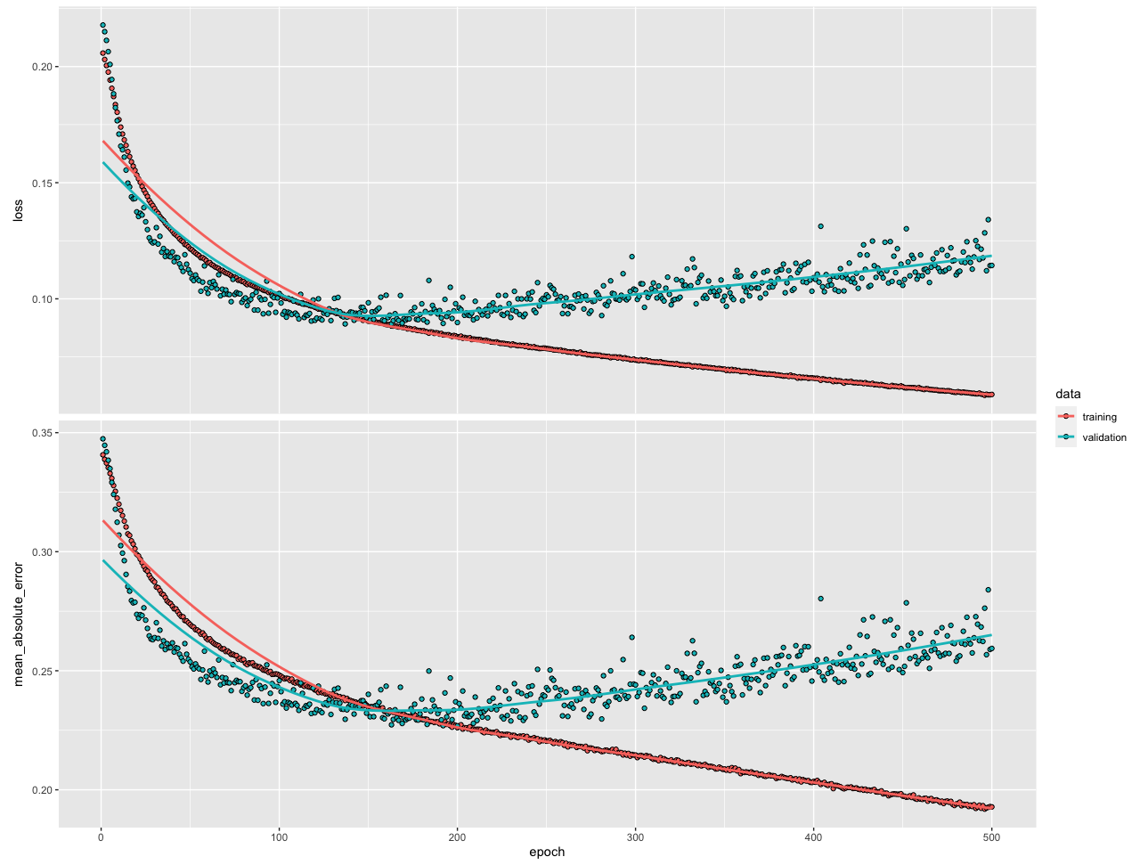

Slide 108
overfitting
~150

Slide 109
Modify the depth
Dropout
“The key idea is to randomly drop units (along with their connections) from the neural network during training. This prevents units from co-adapting too much.” (Srivastava et al. 2014)
i
h₁
h₂
o
i
h₁
h₂
o
~0.5
L₁ and L₂ regularization
(Ng 2004; Schmidhuber 2015)
“Regularization is any modification we make to a learning algorithm that is intended to reduce its generalization error but not its training error” (Goodfellow et al. 2016)

Slide 110
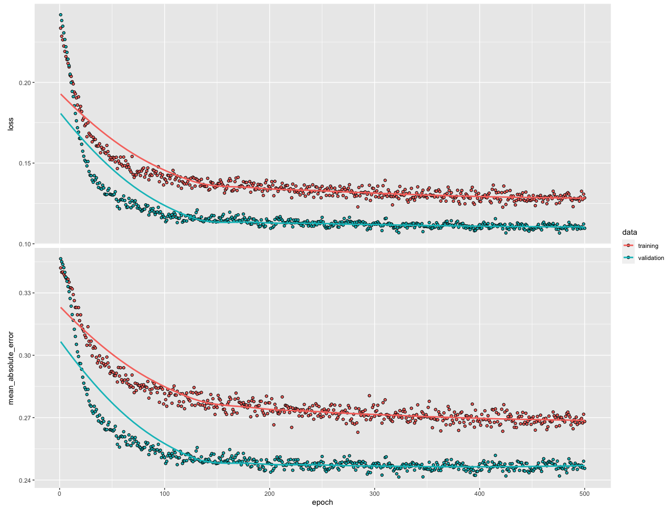

Slide 111
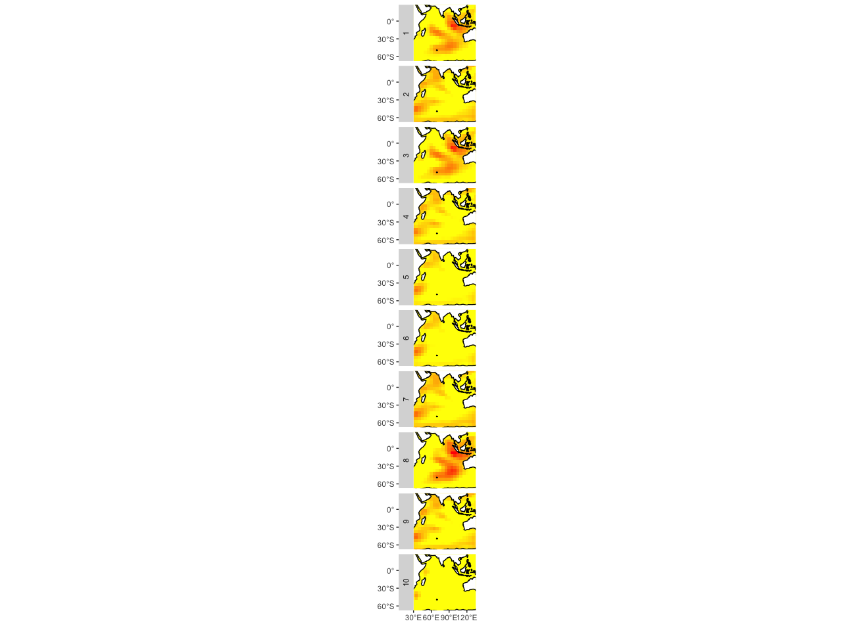
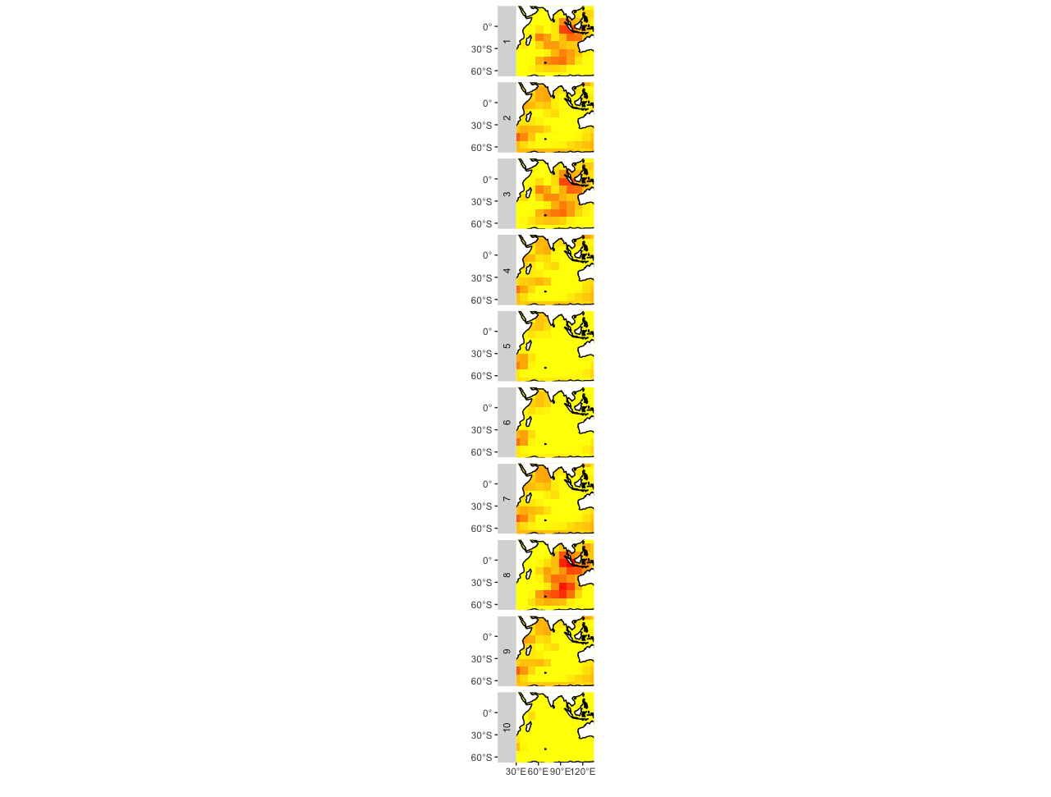
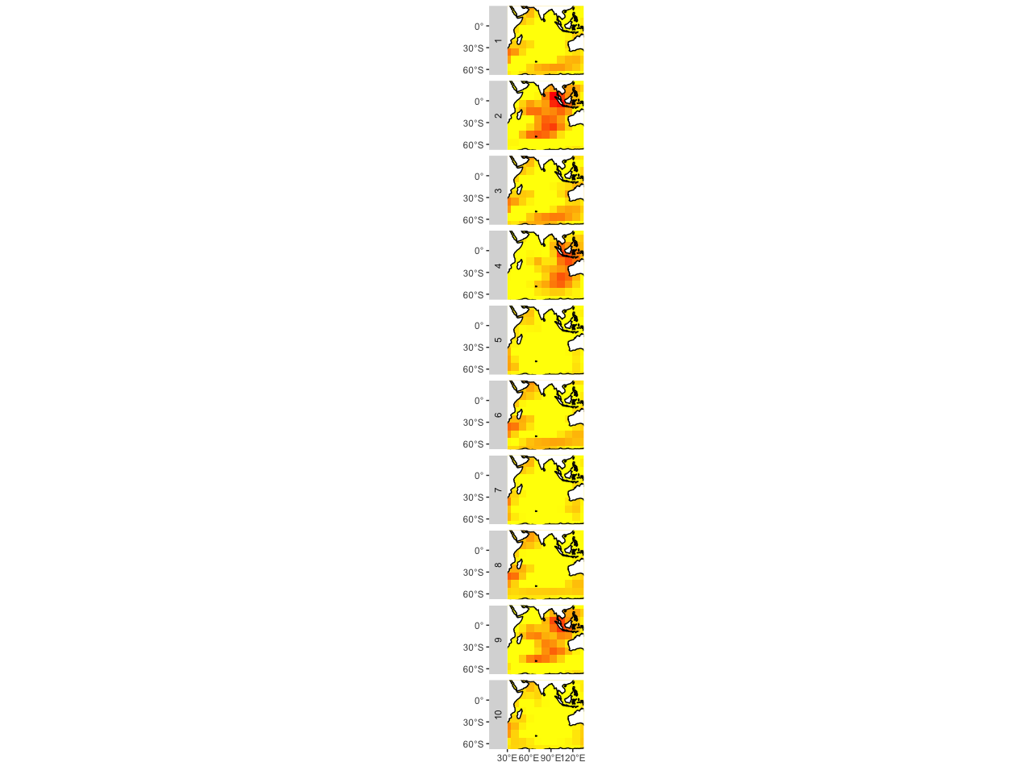
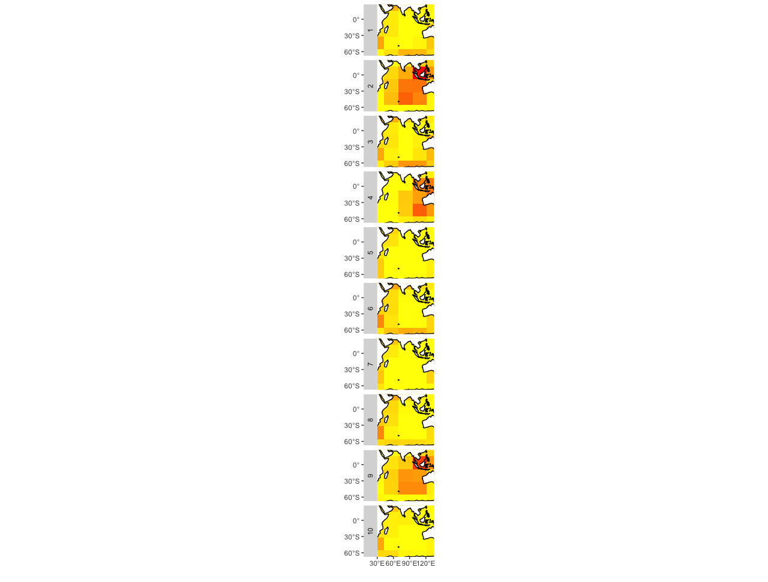
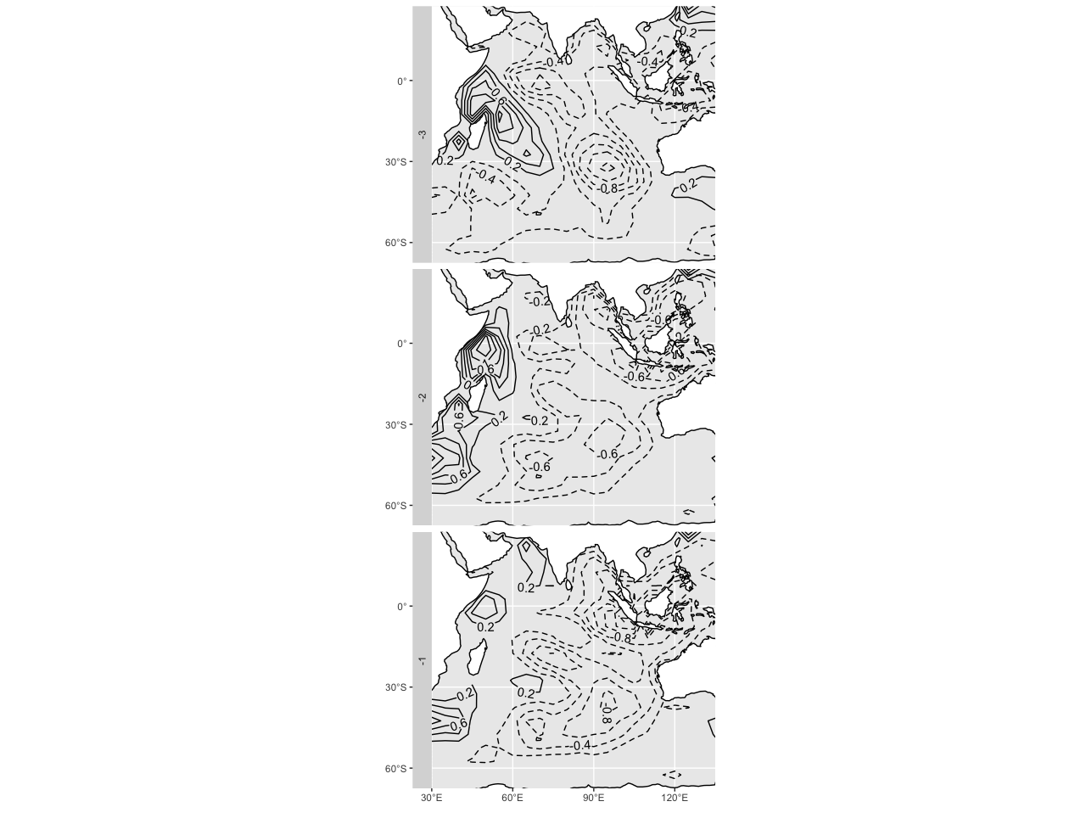
Convolution
Pooling
Convolution
Pooling
DMI in 1961-09-01
Notes:
What the convolution layers “see” with 10 filters. Example of DMI in September 1, 1961. SST maps are 1, 2, and 3 months before.

Slide 112
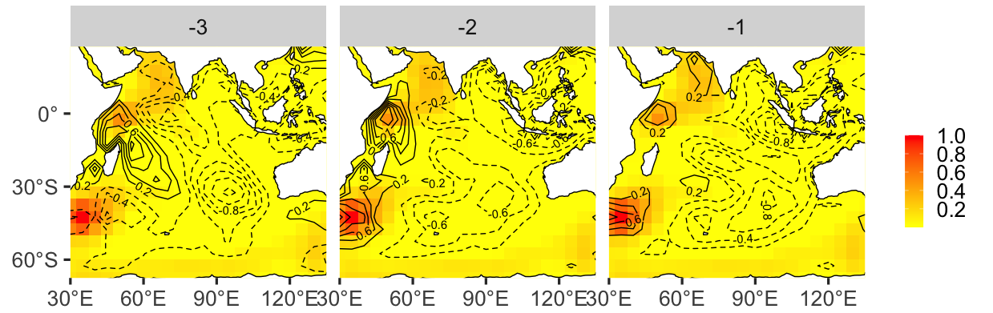
Visual explanation of CNN with Grad-CAM (Selvaraju et al. 2020)
Notes:
Selvaraju, R. R., M. Cogswell, A. Das, R. Vedantam, D. Parikh, and D. Batra, 2020: Grad-CAM: Visual Explanations from Deep Networks via Gradient-Based Localization. Int J Comput Vis, 128, 336–359, https://doi.org/10.1007/s11263-019-01228-7.

Slide 113
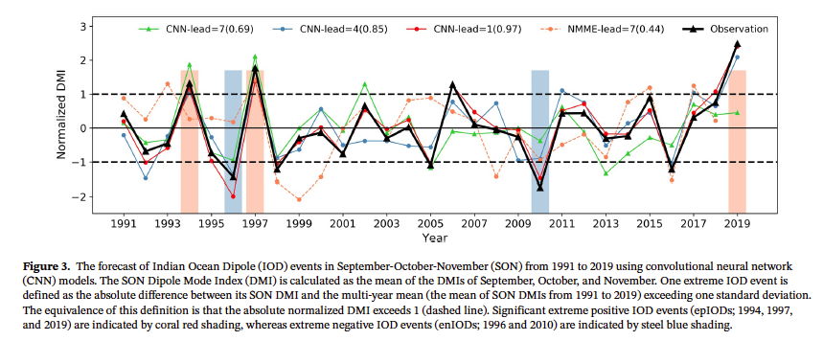
Liu, J., Y. Tang, Y. Wu, T. Li, Q. Wang, and D. Chen, 2021: Forecasting the Indian Ocean Dipole With Deep Learning Techniques. Geophys Res Lett, 48, https://doi.org/10.1029/2021GL094407.

Slide 114
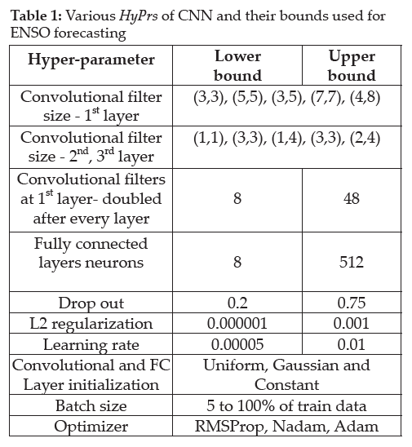
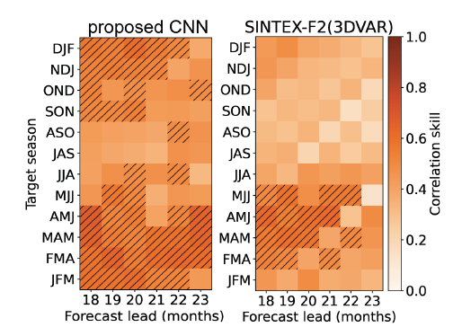
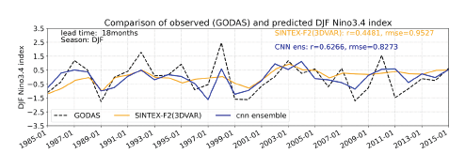
Patil, K. R., T. Doi, P. Oettli, J. V. Ratnam, and S. K. Behera, 2021: Improving long-lead predictions of ENSO using convolutional neural networks. CLIVAR Exchanges Special Issue: Advances in Climate Prediction Using Artificial Intelligence, 81, 8–11.

Slide 115
Some Advices

Slide 116
Splitting the data to improve the robustness of the model:
Training subset
Validation subset
Evaluation subset
Modifying the learning strength to reduce the overfitting:
Reduce the depth of the learner
Dropout
L₁ and/or L₂ regularization
During training, comparing the metrics for both training and validation subsets
Modifying the hyperparameters:
Number of filters in the convolution layer(s)
Number of nodes in the hidden layer(s)

